Slide 1

A cost-effectiveness analysis of telemedicine and mobile health interventions to support continuing care for patients receiving treatment for alcohol use disorder…and other explorations of cost-effectiveness related to mobile health
April 12, 2023
Andrew Quanbeck, Ph.D.
Associate Professor
Department of Family Medicine and Community Health
University of Wisconsin-Madison
isel.wisc.edu

Slide 2
Acknowledgements
NIDA grant K01DA039336 (PI: Quanbeck); NIAAA grant R01 AA02259501 (PI: McKay) NIAAA grant 1R01AA024150-01A1 (PI: Quanbeck)
Special thanks to James McKay & David Gustafson, Xiang Li, Megan Ivey, & Daniel Polsky (coauthors and collaborators)

Slide 3
Declarations
I have a shareholder interest in CHESS Mobile Health, a health care technology company that licenses digital health technologies for use by patients and family members struggling with addiction.

Slide 4
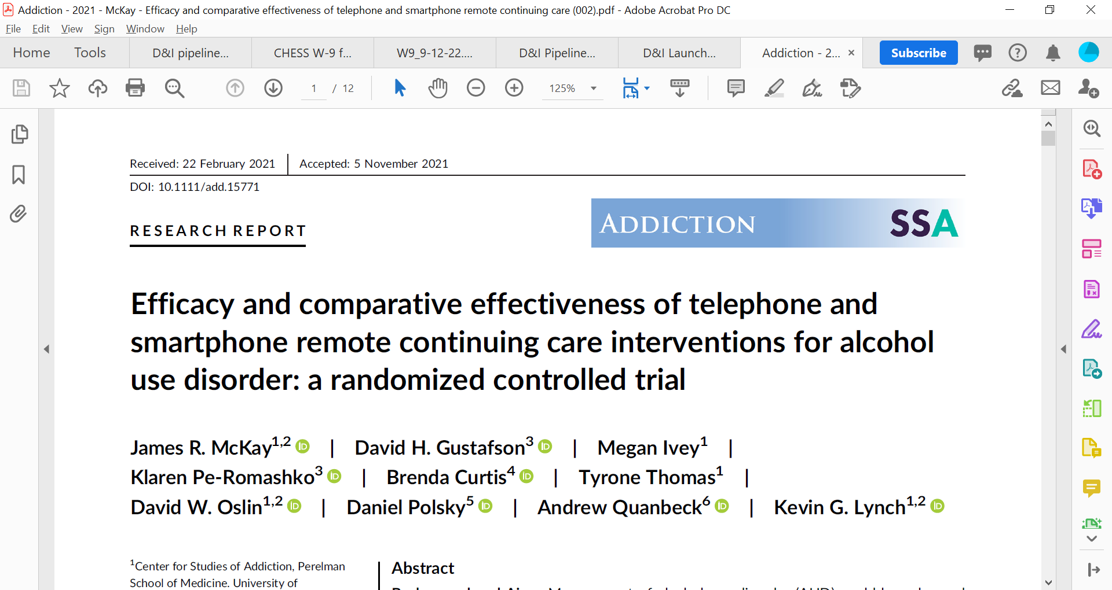
Main results of parent trial I’ll be covering today…

Slide 5
Telephone Monitoring and Counseling (TMC)
Prior studies on TMC for alcohol use disorder (AUD):
  TMC produced better alcohol use outcomes (self-report and biological) than standard group aftercare (McKay et al., 2005) in IOP graduates
  TMC improved alcohol use outcomes when added after 4 weeks of longer IOPs (McKay et al., 2010)

Slide 6
Other TMC findings
Positive effects of TMC have been greater (or entirely) in:
  Poorer prognosis patients: continued cocaine/alcohol use early in IOP, low motivation or poor social support after 4 weeks of IOP, more prior SUD TX
  Women
TMC has been found to be cost-effective and cost-beneficial compared to standard care (McCollister et al., 2016; Shepard et al., 2016)

Slide 7
Smartphone SUD interventions
Two main types:
  Evidence-based SUD intervention turned into digitized modules that can be completed on smartphone or computer
    CBT4CBT (Carroll)
    Community Reinforcement Approach (reSET, reSET-O) CRA + CM
  Package of other recovery supports
    ACHESS (Gustafson)
    Dynamicare (Gastfriend) CM, monitoring, coaching
    WeConnect: CM, monitoring, coaching

Slide 8
ACHESS Smartphone Recovery Support
Based on self determination theory
Access to a care manager or counselor, family, friends, sponsor, etc.
Access to discussion groups, other recovery supports, web links, journaling
Tailored information regarding coping with stressors
GPS functions, including alerts to counselors and peer supports when patients approach risky geographic areas
Alerts/reminders of appointments
Ongoing mini assessments and check-ins (monitoring)
Panic button (patient or GPS activated)

Slide 9
Initial ACHESS Trial with Patients with AUD
Residential patients (N= 349) randomly assigned at discharge to receive ACHESS or not for 8 months
Alcohol use outcomes assessed over 12 months
Results: Lower frequency of risky drinking days in ACHESS compared to TAU (49% reduction, p= .003).
Also higher abstinence rates in ACHESS at:
  8 months (78 vs. 67%; p< .04)
  12 months (79% vs. 66%; p< .04)
Gustafson et al. (2014) JAMA Psychiatry

Slide 10
Examining Impact of Adding
TMC, ACHESS, and TMC+ACHESS to TAU

Slide 11
Combining Counselor Provided Continuing Care and Automated Recovery Mobile Health Support
ACHESS and TMC have complementary strengths.
  ACHESS provides automated 24/7 recovery support services, but not regular contact with a counselor.
  TMC provides regular contact with the same counselor, but not ongoing support between calls.
The future of continuing care is likely to involve automated mobile technology and counselor contact, but little is known about how best to integrate these services.

Slide 12
Study Design
Mobile health enhancements to continuing care for patients with AUD in community clinics (NIAAA R01):
  2 x 2 design:
    Automated smartphone program with multiple functions (ACHESS—12 months)
    Telephone Monitoring and Counseling (TMC—12 months)
    Combination of ACHESS and TMC (TMC+ACHESS– 12 months)
    Treatment as usual
  Follow-ups a 3, 6, 9, 12, and 18 months
  Participants are patients at several publicly funded SUD IOPs in Philadelphia.
  Economic component (cost-effectiveness)

Slide 13
Study Hypotheses
Primary
  TMC, ACHESS, and TMC+ACHESS will be superior to TAU on the primary outcome, Percent Days Heavy Drinking (PDHD)
  TMC+ACHESS will be superior to TMC and ACHESS on PDHD
Secondary
  Comparison of TMC and ACHESS on PDHD
  Secondary outcomes: Any drinking, any drug use, quality of life, %dCDT

Slide 14
Treatment Conditions
ACHESS
Patients were given an android smartphone, data plan, and the ACHESS program.
Research techs taught participants how to use ACHESS (and in some cases smartphones) and loaded relevant information into ACHESS
Participants could get technical support from research techs in Philly or UWisc.
Non-clinical staff from UWisc monitored data from ACHESS, including panic button activation, worrisome monitoring data, and chat room discussions.
Supportive text messages sent to participants who were struggling

Slide 15
Telephone Monitoring and Counseling (TMC)
  A “CBT lite” intervention that combines brief assessment, IDing high risk situations, coping skills work in 20-30 min calls
  Weekly calls gradually titrated down to every other month, for a total of 16 calls over 12 months.
  Participants remain with same counselor across calls
TMC plus ACHESS
  All features of each intervention
  Integration of both: ACHESS as clinician extender
  Responses to smartphone assessments available in a “Dashboard” that counselors can access anytime. Prompts between session contact
  Alerts based on concerning ACHESS data sent to counselors via email and SMS
  Counselors can interact with participants via the chatroom, and can steer participants toward greater use of smartphone features

Slide 16
Stats and Power
Generalized estimating equations (GEE) used to compare treatment conditions over 5 follow-ups, controlling for baseline PDHD
  Main effects and treatment interactions
  Focused comparisons between treatment conditions
Effects of missing data examined with pattern-mixture analyses and linear mixed effects models
Power
  Main effects in 2 x 2: 80% power at 5% significance for d= 0.28
  Focused contrasts: 80% power at 5% significance for d= 0.37

Slide 17
Consort Diagram

Slide 18
Study sample
Table 1 Sample characteristics at baseline.
Variable |  |  | Total (N = 262) | TAU (N = 65) | TMC (N = 59) | A-CHESS (N = 68)
Demographics
 | Race
 |  | African American (%) | 82.44 | 81.54 | 83.05 | 86.76
 |  | Others (%) | 17.56 | 18.46 | 16.95 | 13.24
 | Gender (% male) |  | 70.61 | 67.69 | 67.8 | 77.94
 | Age (years) |  | 46.9 | 46.7 | 46.07 | 48
 | High School Education (%) |  | 70.61 | 66.15 | 72.88 | 67.65
 | Never married (%) |  | 66.79 | 70.77 | 64.41 | 66.18
 | Days Heavy Drinking |  | 34.33 | 31.01 | 34.06 | 37.88

Slide 19
Continuing care participation
Number of TMC sessions in those who completed orientation:
  TMC: 10.2 (N= 43 of 59)
  TMC+ACH: 11.00 (N= 60 of 70)
Days per month ACHESS used:
  Months 1-2
    ACHESS: 20
    TMC+ACH: 16
  Subsequent Months:
    ACHESS: 14
    TMC+ACH: 10

Slide 20
Primary effectiveness analysis

Slide 21
Summary of results
TMC and ACHESS both reduced PDHD about 50% during the 12 month treatment phase relative to TAU. Effects were not present at 18 months, however.
TMC+ACHESS also reduced PDHD about 50% during treatment, with results sustained at 18 months
TMC also reduced rate of any drinking compared to TAU during but not after treatment
Suggestion that TMC+ACHESS also reduced rates of any drug use at 12 and 18 months relative to TAU (15 to 23 percentage point difference), but not significantly
TMC, ACHESS, and TMC+ACHESS did not differ on any of the outcomes

Slide 22
Why wasn’t TMC+ACHESS better than TMC or ACHESS?
Ceiling effects may have been present
Counselors may have not fully utilized information in the dashboard to speed up outreach to struggling patients
Info generated by ACHESS may have not accurately captured relapse vulnerability, due to missing data or inaccurate responses
Although TMC and ACHESS presumably have different mechanisms of action, combining them may not have had anticipated synergistic or additive effects

Slide 23
What is cost effectiveness analysis all about?
Cost effectiveness as constrained optimization
“Constrained optimization is the process of identifying how to achieve the largest amount of some desired outcome or outcomes given one or more constraints” (Neumann et al., 2016)
Our economic analysis of the TMC-ACHESS study uses a combination of trial-based and decision-model based cost estimates

Slide 24
Cost-effectiveness analysis- Methods
(from: Neumann, P. J., Sanders, G. D., Russell, L. B., Siegel, J. E., & Ganiats, T. G. (Eds.). (2016). Cost-effectiveness in health and medicine. Oxford University Press.)
Define the set of possible intervention choices
Identify the desired outcomes
Identify the relevant constrained resources
Identify the effects and costs associated with each of the choices
Eliminate dominated choices
Describe the tradeoffs associated with all the possible choices and identify choices that are optimal given these tradeoffs

Slide 25
Define the set of possible intervention choices
Based on the results of the parent study, a reasonable case could be made for payers to provide either a telemedicine-based approach like TMC or a mHealth intervention like A-CHESS for treatment of alcohol use disorder, but not for offering both in combination.
Thus, our two alternative choices are TMC (telehealth) or A-CHESS (mHealth).

Slide 26
Identify the desired outcomes
In the parent trial (McKay et al., 2021), the primary effectiveness measure was average percent reduction in heavy drinking days for each group;
We converted the percent reduction in each group to an average number of drinking days reduced per client over a 12-month period to aid in interpretability of outcomes for policymakers, consistent with prior evaluations of TMC (McCollister et al., 2016).

Slide 27
Identify the relevant constrained resources
Consistent with prior economic evaluations of TMC (McCollister et al., 2016), primary cost categories included personnel, buildings/facilities, and equipment costs.
As in most health economic studies, labor cost predominate
Unit costs were calculated based on time of the staff spent on preparing and delivering TMC calls, missed TMC calls, monitoring A-CHESS, and app server setup and maintenance; and the average salary of the respective individual performing each task (Counselor Salary in United States, n.d.).

Slide 28
Identify the effects and costs associated with each of the choices
For each group , the incremental cost-effectiveness ratio (ICER) was calculated as the difference in intervention costs divided by the difference in effectiveness:
[Costs(intervention) – Costs(control)] / Effectiveness(intervention) – Effectiveness(control)] = ICER (intervention vs. control)
The ICER represents the additional cost of each intervention group compared to the control group relative to achieve a one-day reduction in risky drinking days.

Slide 29
Eliminate dominated choices
This step simply implies a stopping rule for decision alternatives that are both less costly and more effective than another decision alternative, in which case one alternative dominates the other and there are no meaningful tradeoffs to examine.

Slide 30
Describe the tradeoffs associated with all the possible choices and identify choices that are optimal given these tradeoffs
Because our cost estimates are particular to the unique settings in which the parent study was conducted, we included sensitivity analyses to evaluate implications of modifying key parameters in our telehealth and mHealth delivery models and target population to examine issues of generalizability to other settings
  Varying population characteristics- patient provided vs. payer provided technology.
  Zero buildings/facilities costs (i.e., fully remote staff)
  Examining potential economies of scale- Payers with smaller vs. larger patient populations

Slide 31
Effectiveness results – converted metric
Participants in the TMC, A-CHESS, and TMC+A-CHESS groups had an average of 31.62, 40.60, and 32.89 fewer days heavy drinking over the 12-month intervention compared to the control group, respectively, when adjusting for baseline rates of heavy drinking at the individual level.

Slide 32
Results – base case scenario

Slide 33
Incremental cost-effectiveness analysis- base case

Slide 34
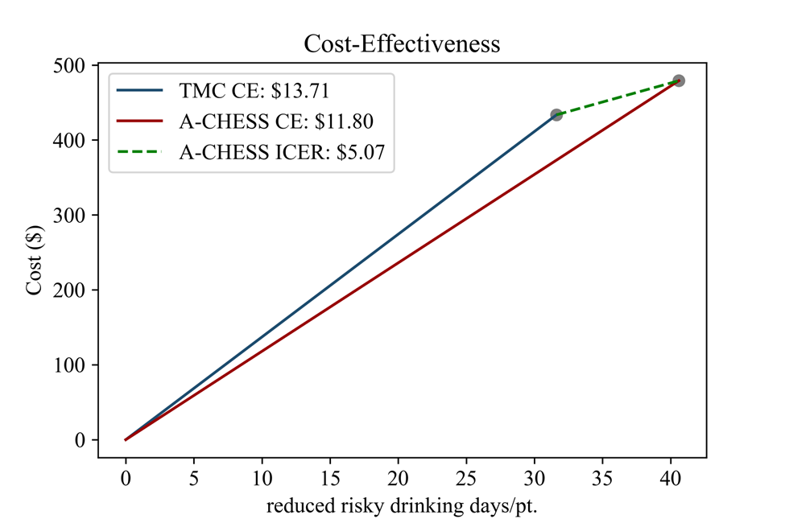
Incremental cost-effectiveness analysis- base case

Slide 35
Alternative scenario 1: phones/data plans provided for patients
Table 2 TMC and A-CHESS intervention cost analyses (2019 dollars).
 | Intervention costs | Summary cost | Summary cost
 |  | TMC (N = 59) | A-CHESS (N = 68)
 | Personnel | $20,152 | $27,152
 | Buildings/facilities | $5,427 | $5,427
 | Equipment | $21,240 | $58,752
 | Total annual intervention cost | $46,819.21 | $91,331.43
 | Cost per patient | $793.55 | $1,343.11

Slide 37
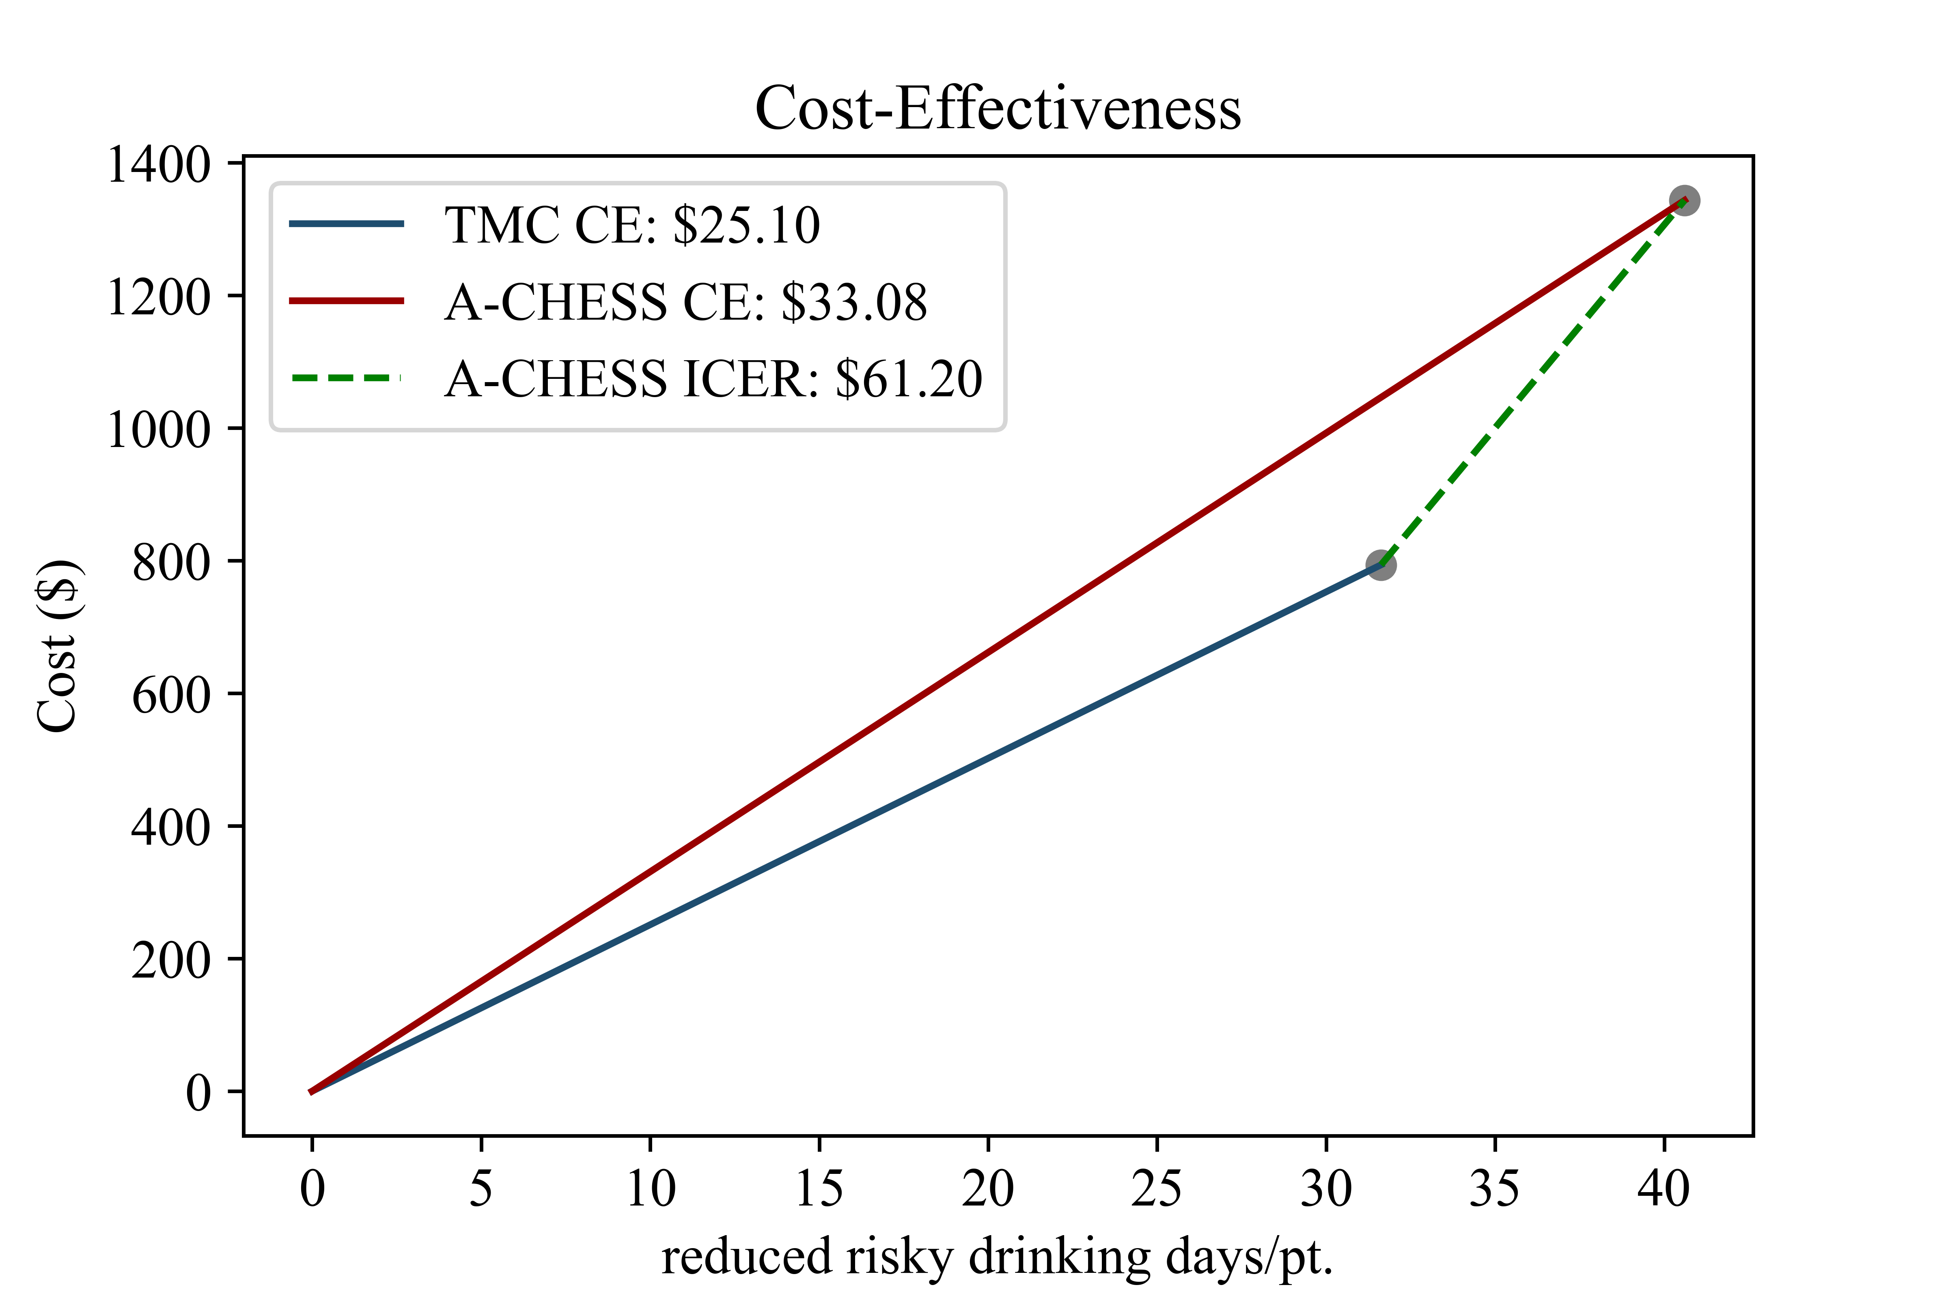

Slide 38
Alternative scenario 2: fully remote counselors

Slide 39
Table 3 Incremental cost-effectiveness ratios for alternative scenario 2
 | Group | Cost/pt. | RHD days/pt. | avg. CE | ICER
 | Control | 0 | 0 | - | -
 | TMC | $341.56 | 31.62 | $10.80 | $10.80
 | A-CHESS | $399.30 | 40.6 | $9.83 | $6.43

Slide 40
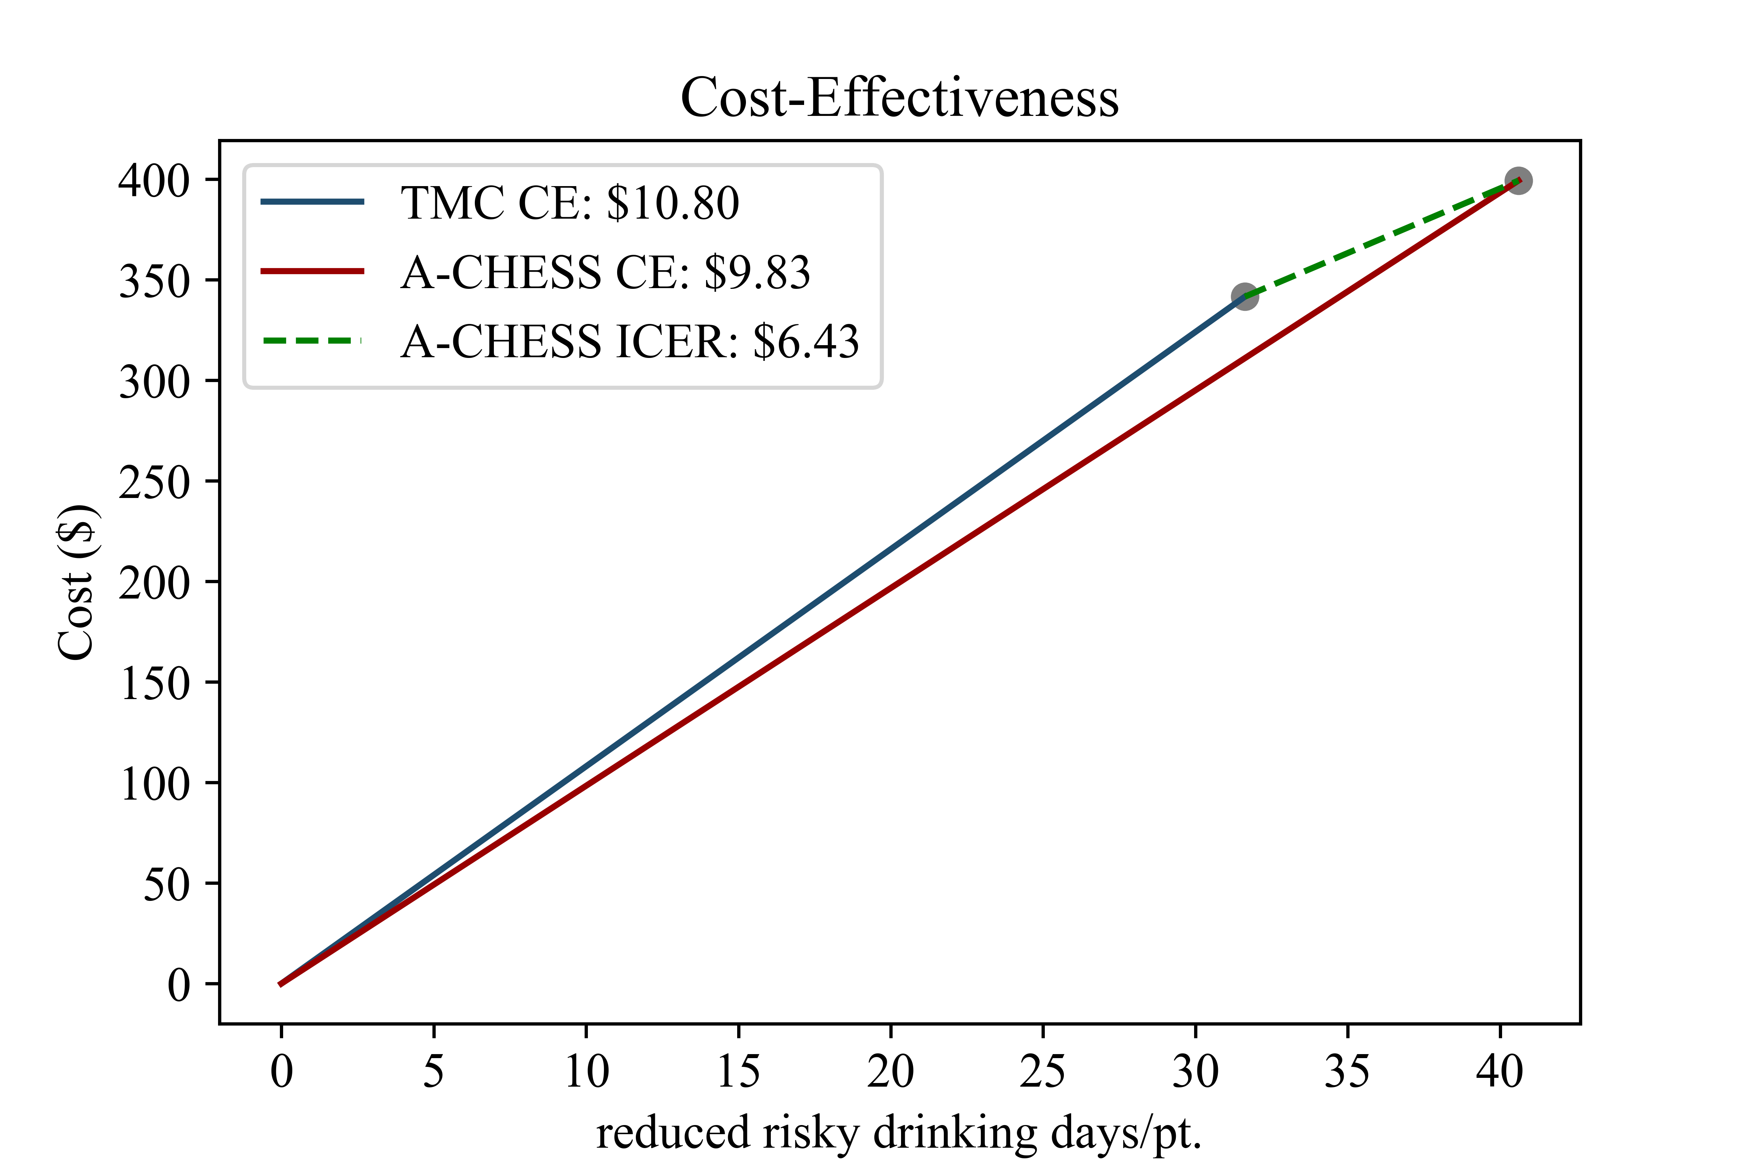

Slide 41
How to factor potential economies of scale?
Cost of TMC scales in more-or-less linear fashion (1:1, synchronous communication channel)
Cost profile of A-CHESS starts with higher fixed costs and marginal cost depends on number of active users (1:many, asynchronous communication channel)
Theoretically, there is a breakeven point in terms of population size in which the marginal cost of adding the next patient becomes lower for A-CHESS than TMC
(We are still working on these calculations)

Slide 42
Implications
The present study is the first to directly compare the cost-effectiveness of evidence-based mHealth and telemedicine approaches for the treatment of alcohol use treatment, and among the first studies in any domain of healthcare to feature a direct comparison between mHealth and telehealth modalities for chronic disease management.
Results of this study may inform healthcare policymakers and decision makers on the costs and effects of telehealth and mHealth systems for reducing alcohol use and provide guidance on the most cost-effective approaches to incorporating technology-supported treatment into health care delivery systems for chronic disease management.

Slide 43
Implications
A-CHESS or TMC both represented cost-effective intervention choices for providing continuing care to patients with alcohol use disorder.
There was no clear evidence supporting the use of one intervention vs. the other. Rather, the decision about whether to use TMC or CHESS will depend (in part) on:
  policymakers’ overall willingness to pay for reducing risky drinking in the populations they serve;
  pragmatic factors related to organizational context (including the socio-economic status of the patient population and overall size of the population served)

Slide 44
Other digital health research
We are now seeking to scale up and implement the system for a broad population of adults with mild to moderate alcohol use disorder.
Using stakeholder values to adapt the intervention and the implementation strategy to the setting and population
Focus on sustainable delivery models for mHealth and cost-effectiveness of different integration models

Slide 45
UW Health - Madison, WI – primary healthcare system with approx. 155,000 primary care patients

Slide 46
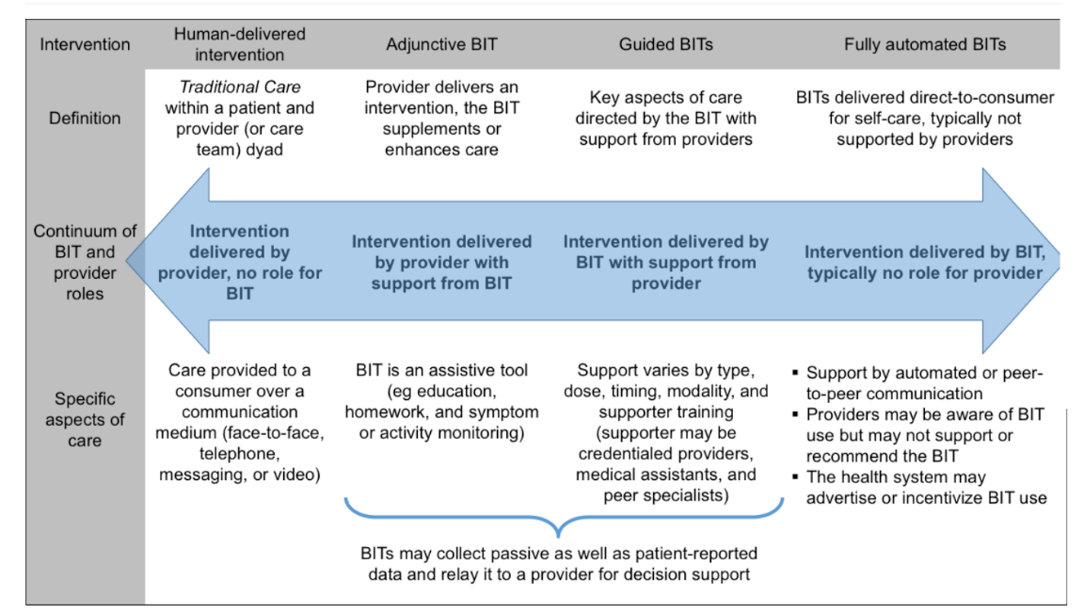
The spectrum of digital health integration strategies
Hermes, E. D., Lyon, A. R., Schueller, S. M., & Glass, J. E. (2019). Measuring the implementation of behavioral intervention technologies: recharacterization of established outcomes. Journal of medical Internet research, 21(1), e11752.

Slide 47
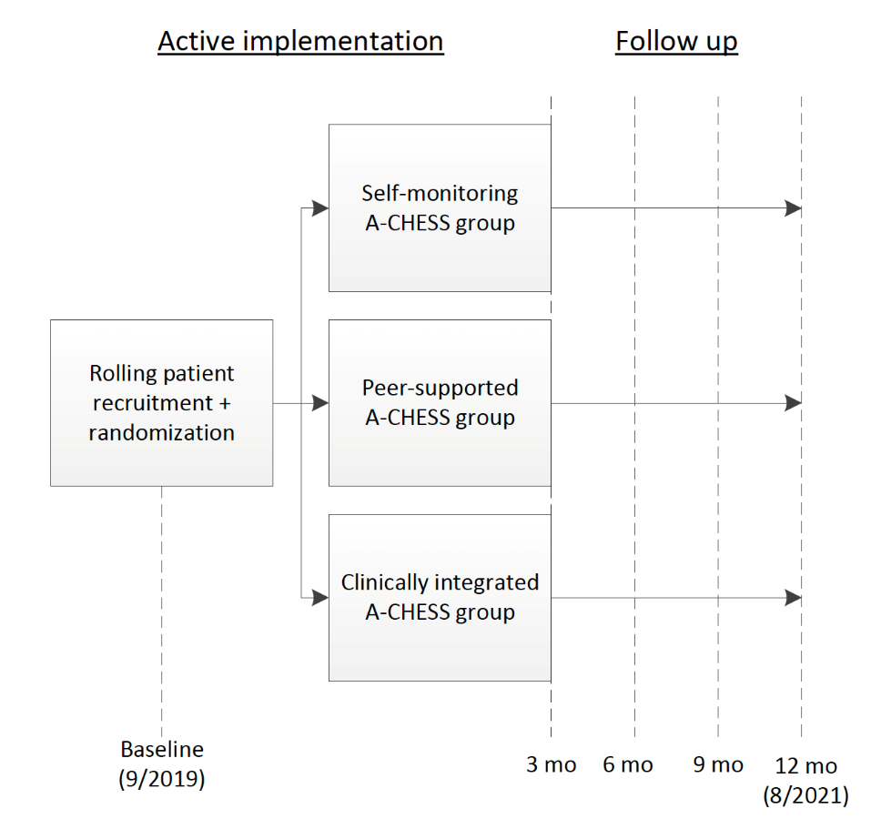
Study design

Slide 48
Self-monitoring group
In the group that uses Tula on their own (the self-monitoring group), participants will have access to the static content in Tula and can reach the study coordinator through private messaging. This line of communication is intended to give patients a way to get answers to procedural questions about the study, not a way to obtain support for behavioral changes. Users in this group will not have access to a discussion group with others using the app.
Patients use the app “on their own” (like most health apps)

Slide 49
Peer-monitored group
In a second group, the peer-monitored group, participants have access to the static content in Tula, but also support from peers in a discussion group and from a trained peer who functions as the discussion group moderator. Participants in this group will also be able to send private messages to others in the peer-supported group (using usernames they create, not their real names) as well as to the peer moderator.
This is a ”community-based” integration model

Slide 50
Clinically integrated group
In the clinically integrated group—the “high touch” group in this study--participants will have access to the same services as participants in the peer-monitored group, but a health coach will replace the trained peer and offer more intensive, one-to-one interaction with participants. Coaches are trained to help patients achieve their own goals for health and wellness.
This group operates under the auspices of the healthcare system to the extent that the health coach is a UWHealth employee

Slide 51
Outcomes
Dimension | Measure | Source | Timing (after randomization)
Patient outcomes
Risky drinking days | Timeline followback^{58,59} | Patient survey | 0, 3, 6, 9, 12 mo.
Quality of life | PROMIS Global Health⁶⁰ | Patient survey | 0, 3, 6, 9 ,12 mo.
Cost
Healthcare utilization | Medical services utilization form⁶¹ | Patient survey | 0, 6, 12 mo.
Implementation costs | COINS⁶² | Staff interview | Every 6 mos.

Slide 52
Implementation & intervention development model
Aarons GA, Hurlburt M, Horwitz SM. Advancing a conceptual model of evidence-based practice implementation in public service sectors. Adm Policy Ment Hlth. 2011;38:4–23.

Slide 53
A-CHESS adaptations

Slide 54
Fundamental questions about the role of mHealth in primary care we will address in the R01
Is the cost of integrating an mHealth system into a health system worthwhile? Or,
Might it suffice for patients to use mHealth systems on their own, based on the recommendation of the health system?
Or, is a community-based model the best-option?
Ultimately, who will “pay” for mHealth (with both money and time)?
Notes:
So we are left with some fundamental, unanswered questions about the role of mHealth in primary care that we’ll be looking into in our next study. They include:
Is the cost of integrating an mHealth system into a clinic’s operations worthwhile? Or,
Might it suffice for patients to use mHealth on their own, per the recommendation of a PCP?
This really gets to fundamental issues of cost-effectiveness. Our implementation strategy basically strove to achieve integration, and we had mixed success in that regard. If we go further by presenting data to clinicians in the EHR, will they pay attention to it? Or might it be the case that mHealth should be implemented as a tool that patients use on their own, with clinicians knowing nothing about what they’re doing?
Because I got to tell you, the latter is what is happening right now. Maybe that is OK, and actually makes more sense than engaging in costly IT integration efforts.
And the big question- who will “pay” for mHealth (with both money and time) over the long term? Paying is not just about money, although money is certainly a big part of the equation- it’s also critically about time. Can and should we offload the time costs to patients, or expect primary care clinicians to pay with their time, which we’ve been told time and time again is their most scarce and precious resource? These are important questions we don’t have any basis for answering so far and we will be trying to keep moving the needle on them going forward.

Slide 55
Discussion points and questions (this is a work in process!)
Point estimates are just that – point estimates
Cost estimates are highly variable, and
Decision making depends on a lot of contextual factors
What scenarios are most important to examine in terms of tradeoff associated with implementation of mHealth technology?

Slide 56
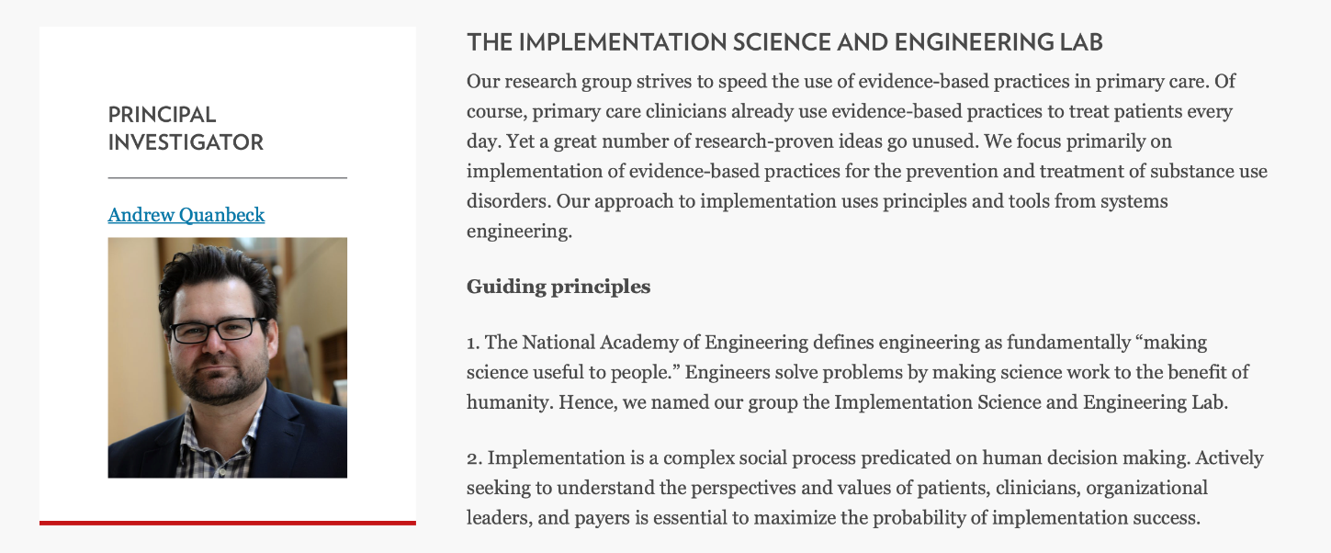
Thanks!
  Andrew Quanbeck
  arquanbe@wisc.edu
  isel.wisc.edu

