Slide 1
PrEP Acceptability among Pregnant Women and Implications for HIV Prevention in Clinical Practice
Division of Infectious Diseases
Florence Momplaisir, MD MSHP FACP
Assistant Professor
Division of Infectious Diseases
March 22, 2022

Slide 2
Outline
HIV Epidemic among women
PrEP Acceptability among Pregnant Women
Implications for integration of PrEP in prenatal care
Studies PrEP implemented: lessons from the global setting
Couples HIV testing and counseling

Slide 3
HIV Epidemic among Women

Slide 4
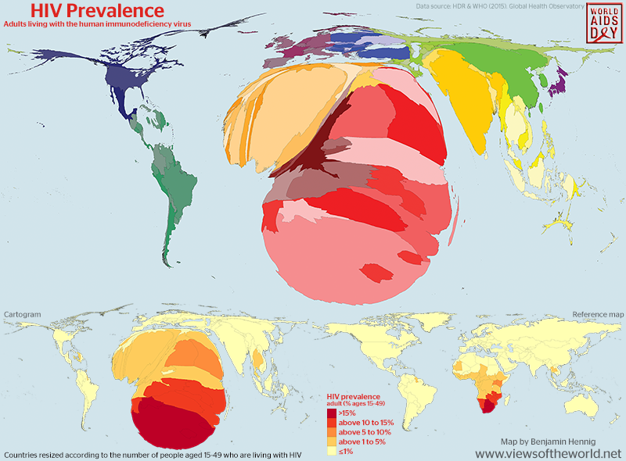
Global Perspective
37.9 million people living with HIV worldwide
  55% WOMEN
  Majority of new cases in Africa, up to 79% in Southern and Eastern Africa
Globally, 1.3 million women with HIV become pregnant each year
Global HIV & AIDS statistics — 2019 fact sheet. UNAIDS website. www.unaids.org/en/resources/fact-sheet.; Facts and figures: HIV and AIDS. UN Women website. www.unwomen.org/en/what-we-do/hiv-and-aids/facts-and-figures.
Notes:
Women comprise 55% of the global total of HIV cases worldwide
Last year alone, 1.7 million people became infected with HIV
Among new cases of HIV in C & W Europe, women account for 20-25% of HIV incidence
However, in parts of Africa and Asia the proportions are reversed and women account for the majority of new cases. For example, among adolescents in Eastern and Southern Africa, females comprise 79% of new cases.
HIV/AIDS has become….
And globally....

Slide 5
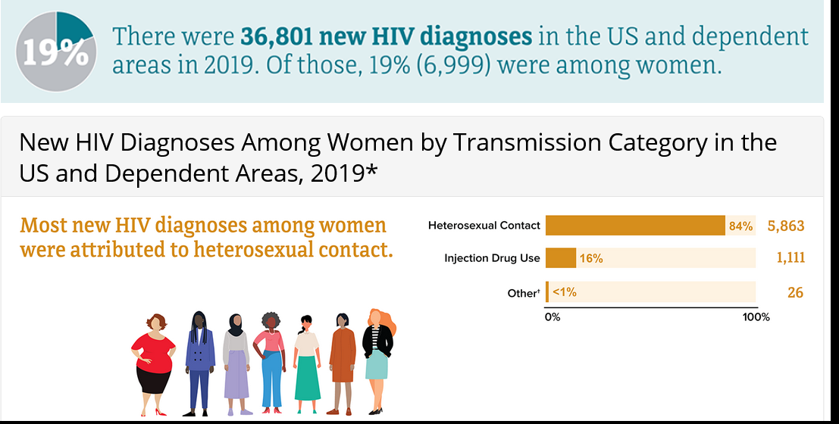
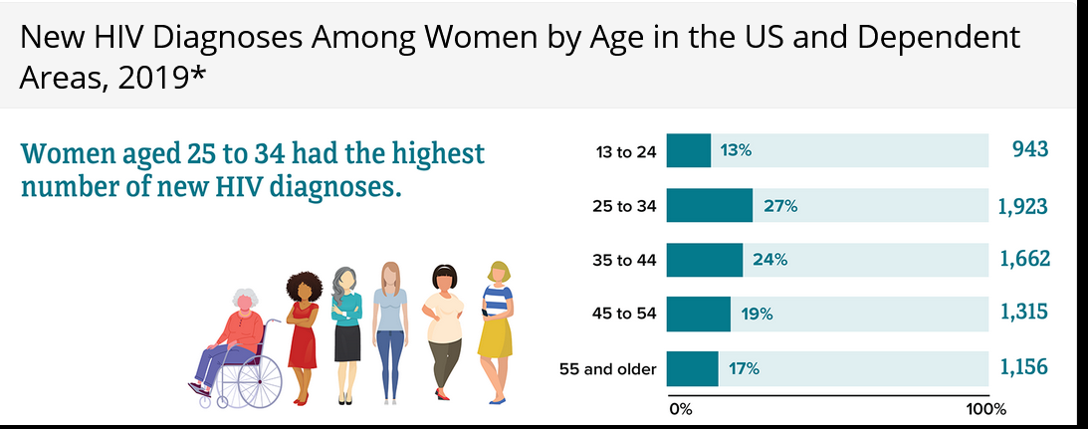
U.S. Perspective
Heterosexual sex is the predominant mode of transmission
Most infections occur among women of childbearing age
https://www.cdc.gov/hiv/group/gender/women/diagnoses.html

Slide 6
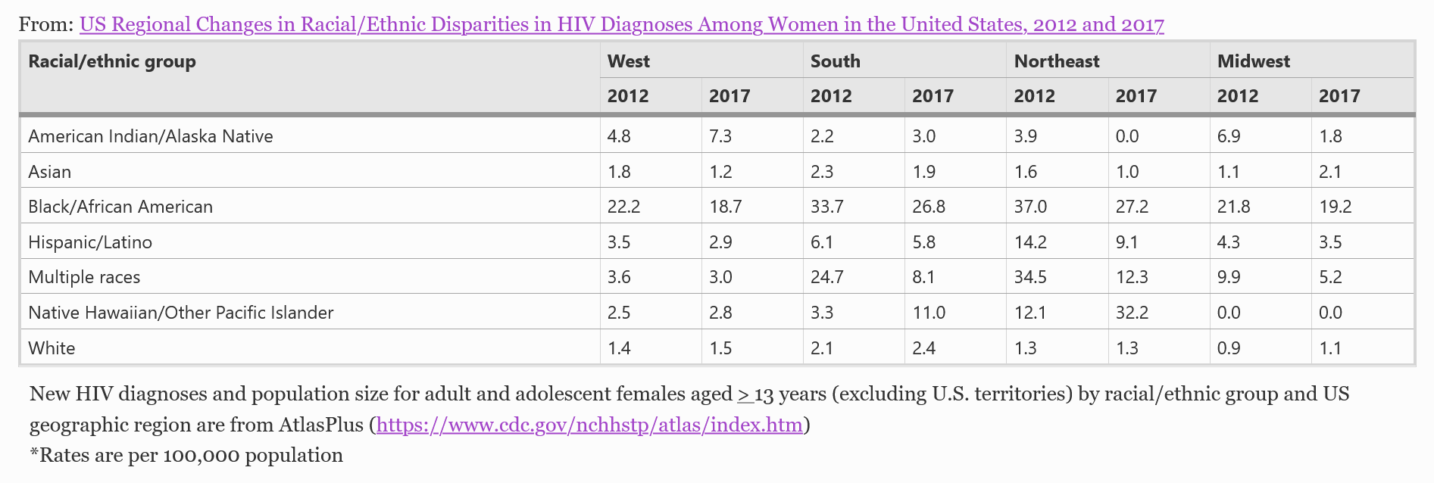
Racial and Geographic Disparities Persist in the U.S.
McCree 2020. AIDS and Behavior, 24(4), pp.1118-1123.

Slide 7
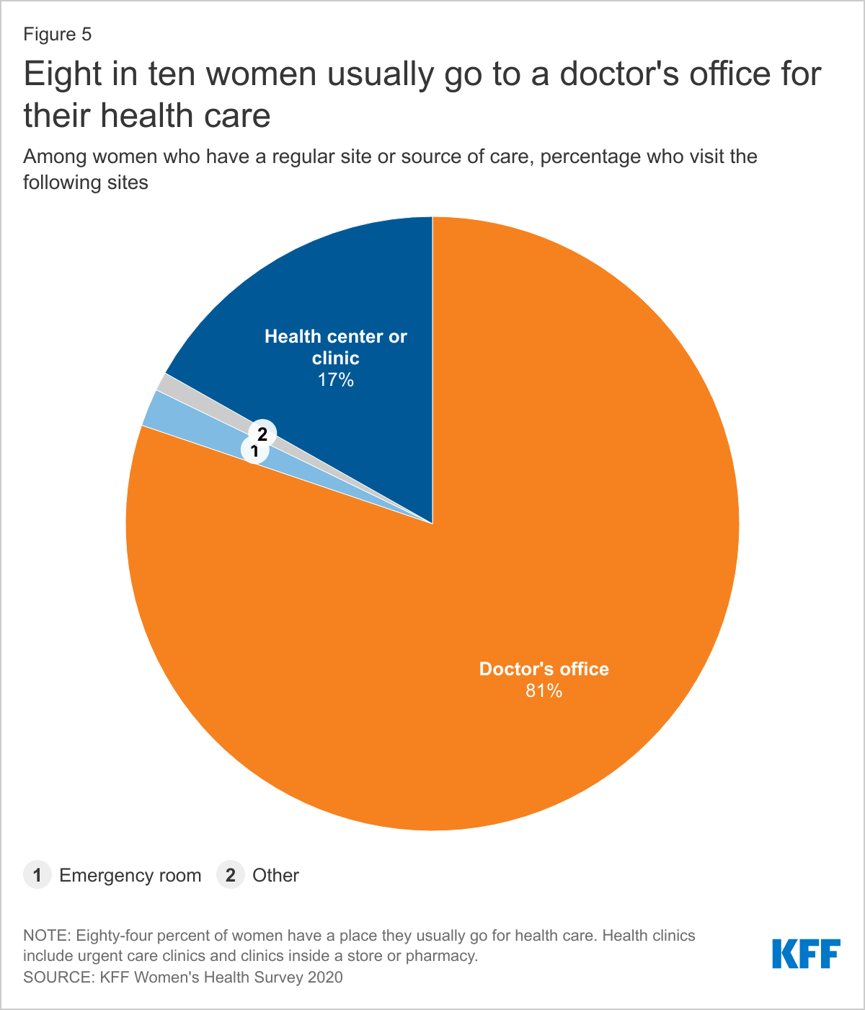
Missed Opportunities for HIV Prevention
Missed Opportunities for HIV Prevention
Women who are more likely to access a non-traditional source of care (urgent care, clinic inside a store or pharmacy):
  Younger
  More likely to be Black of Hispanic
  Uninsured or on Medicaid
For many, prenatal care is the first time that they are accessing routine care
https://www.kff.org/womens-health-policy/issue-brief/womens-health-care-utilization-and-costs-findings-from-the-2020-kff-womens-health-survey/

Slide 8
HIV Risk Among Pregnant and Postpartum Women

Slide 9
Case
Cis-gender woman in a monogamous relationship becomes pregnant.
First trimester HIV test was negative. No 3rd trimester done.
Rapid HIV test at labor and delivery turns positive.
Infant HIV testing done but resulted after hospital discharge, and was positive.
Confirmatory test for mother and baby were positive.

Slide 10
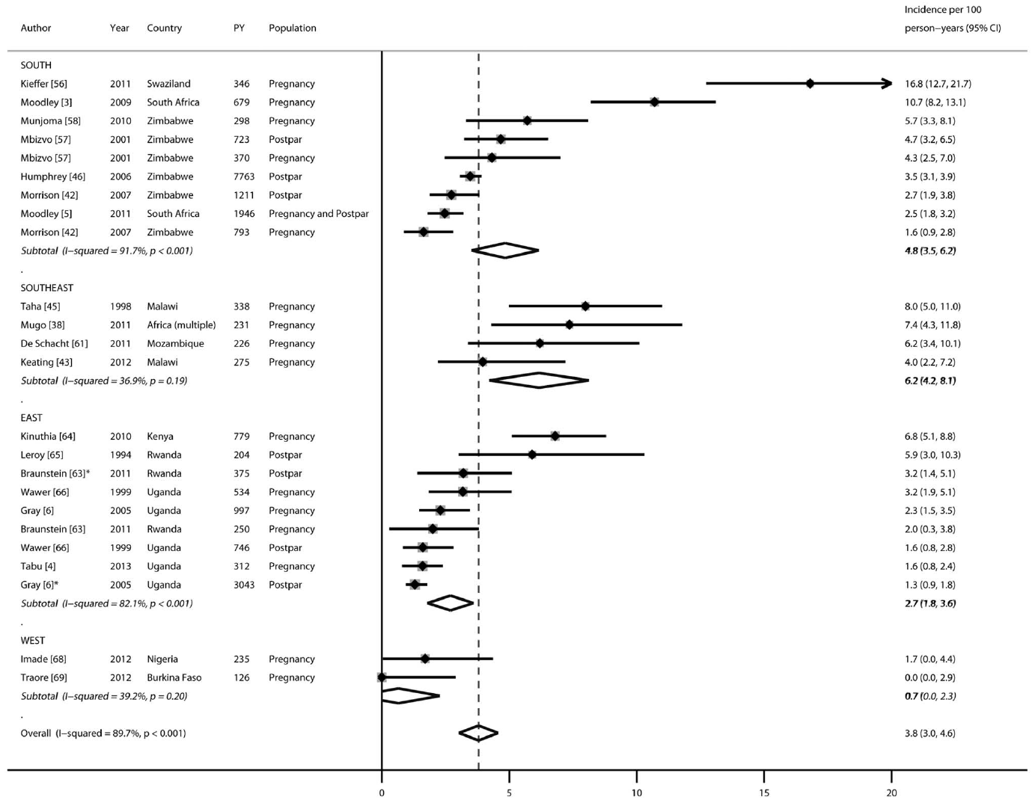
Incident HIV during pregnancy and postpartum
Cumulative incidence:
3.8 per 100 person-years
(95%CI: 2.0,4.6)
Pregnancy: 4.7 (3.3-6.1)
Postpartum: 2.9 (1.8-4.0)
Drake AL et al. PLosMed 2014;11:e1001608
Drake AL et al. PLosMed 2014;11:e1001608
Notes:
HIV incidence among women during pregnancy and postpartum is estimated to be two to six times greater than outside of pregnancy

Slide 11
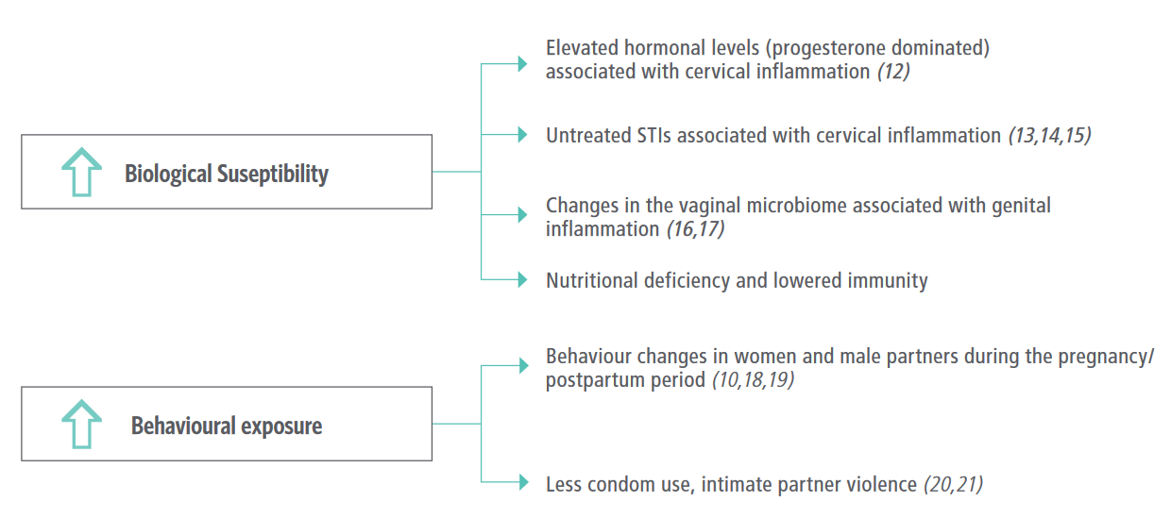
Women may be at increased risk of acquiring HIV during pregnancy, breastfeeding and the postpartum period
Source: Moodley D. 2017 (4).

Slide 12
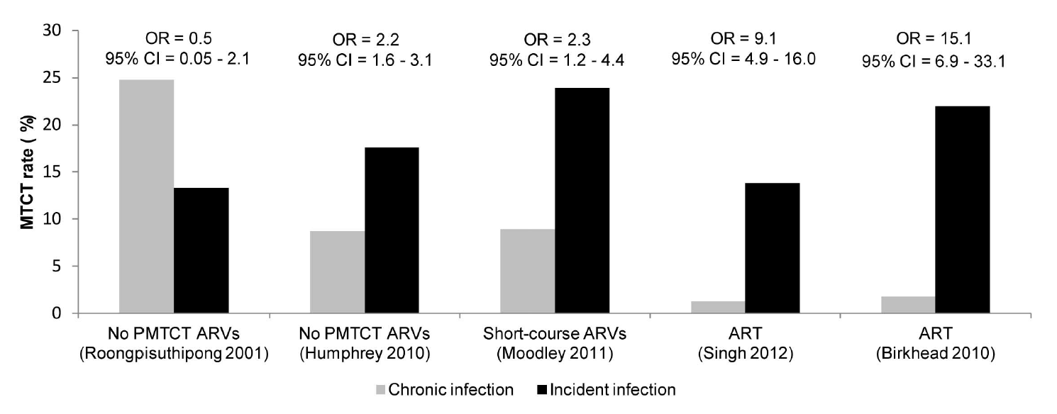
Acute infection associated with greatest risk of perinatal HIV transmission risk
Drake AL et al. PLosMed 2014;11:e1001608

Slide 13
PrEP for Pregnant and Postpartum Women

Slide 14
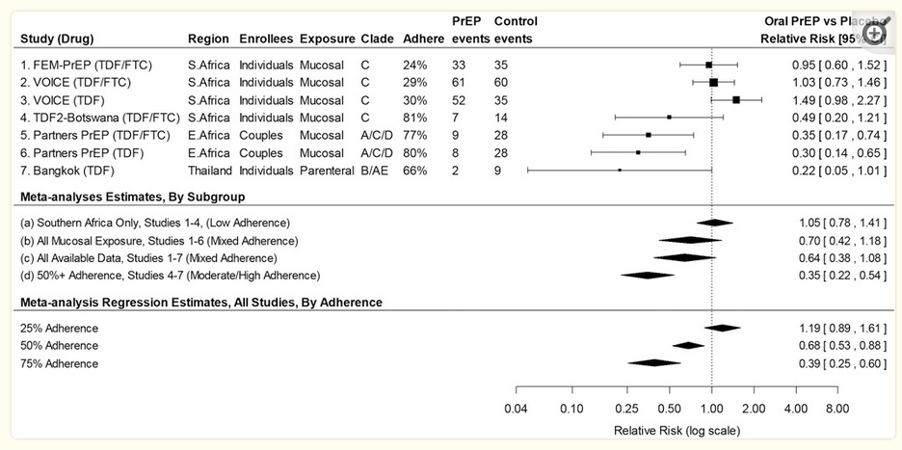
PrEP Clinical Trials Limited to non-Pregnant Women
PrEP effectiveness in preventing HIV-1 acquisition, meta-analysis estimates, and meta-analysis regression results for major PrEP trials in women.
Hanscom B, et al. J Acquir Immune Defic Syndr. 2016;73:606-608

Slide 15
Pregnancy and Birth Outcomes, Partners PrEP Trial
Secondary analysis of Partners PrEP trial
1785 serodiscordant heterosexual couples
Pregnancy incidence was 10.3 per 100 women-years
PrEP discontinued at pregnancy dx
No difference between TDF and placebo
  Pregnancy incidence
  Congenital abnormalities
No evidence in birth outcome and infant growth during the first year of life
Mugo NR, et al. JAMA 2014;312:362-371.

Slide 16
Partners Demonstration Project
Prospective implementation study to understand the feasibility and effectiveness of ART (U=U) and PrEP in delivery settings
1,013 heterosexual HIV-1-serodiscordant couples in Kenya and Uganda
ART and PrEP were offered through a pragmatic strategy, with ART promoted for all couples and PrEP offered until 6 mo after ART initiation by the HIV-1 infected partner
Objective measures of adherence to both prevention strategies demonstrated high use (≥85%)
ªOne case was not using PrEP and entered a new relationship prior to pregnancy. The second case was not using PrEP and ART had not started.
Baeten JM, et al. PLoS Med. 2016;13:e1002099.

Slide 17
Rationale for using PrEP during pregnancy
Large body of data demonstrating the safety of TDF/FTC as treatment in women living with HIV during pregnancy.
Limited but reassuring safety data on TDF/FTC for prevention in pregnancy.
  No evidence of increased congenital anomalies, or adverse maternal or neonatal pregnancy outcomes
PrEP can effectively reduce the risk of HIV acquisition to the mother and her baby.
Woman in control of her risk.

Slide 18
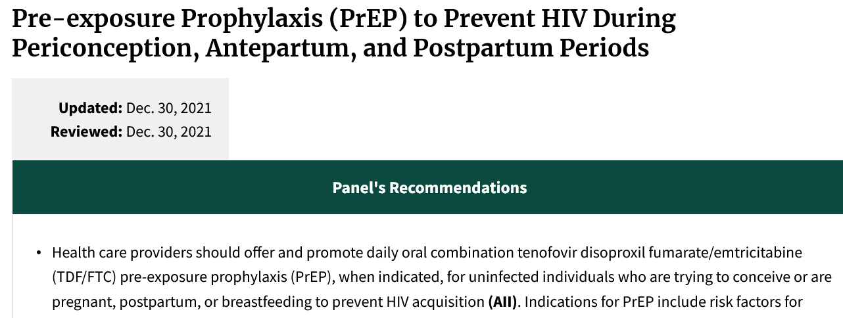
PrEP Recommended for HIV Prevention in Pregnancy
https://clinicalinfo.hiv.gov/en/guidelines/perinatal/whats-new-guidelines

Slide 19
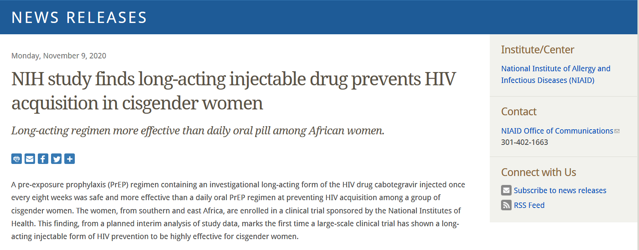
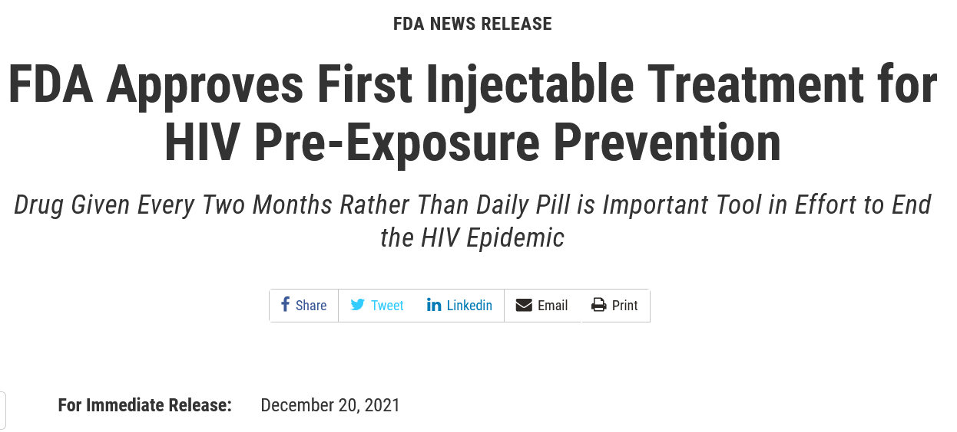
Notes:
Limited data in preg, opportunity PP, although limited to no data for BF women. Could be initially limited to W who do not plan to BF.

Slide 20
HIV prevention in the postpartum period
Women in the postpartum period remain at higher risk of HIV acquisition compared to women outside of the perinatal period.
Perinatal transmission can occur for women who breastfeed.
The postpartum period often disrupts adherence behaviors, making LA-injectable an attractive option for women.

Slide 21
Extrapolating from the experience of women with HIV
Adams, JW., et al. Clin Infect Dis (2015

Slide 22
PrEP Acceptability among Pregnant Women

Slide 23
Integrating PrEP in Prenatal and Postpartum Care
Consolidated Framework for Implementation Research (CFIR)
Intervention characteristics
PrEP characteristics
Outer setting
Economic, political, and social context
Inner setting
OB/GYN clinics
Individuals Involved
Characteristics of patients and sex partners
Implementation process
Integration in routine care
Notes:
We wanted to understand women’s perception of PrEP and the intervention-setting fit using CFIR

Slide 24
PrEP acceptability
In the interview guide, we assessed knowledge, interest, beliefs, and outcome expectancy about oral PrEP in pregnancy and preference for different PrEP formulations in the postpartum period.
Inclusion criteria: women in care at the Dickens Center (Penn prenatal care clinic), age ≥ 14 years, STI during/or the year preceding pregnancy, English speaking, able to consent.
Participants completed a short Redcap survey, followed by an in-depth, semi-structured interview which lasted about 30 minutes (n=20, August 2020-July 2021).
We used deductive and inductive codes for the data analysis, created matrices to explore patterns in findings, and wrote memos to interpret emergent themes.

Slide 25
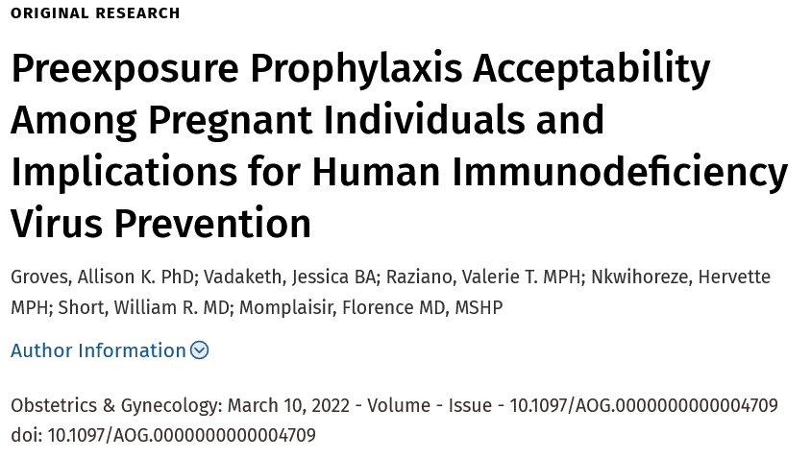

Slide 26
Results
Patient characteristics | N=20
Age, median | 24 | Min 19, max 26
African American | 19 | 95%
Hispanic | 2 | 10%
≥ High school | 23 | 65%
Medicaid | 11 | 55%
Unplanned pregnancy | 14 | 70%
Unprotected sex >1 partner in last Y | 10 | 50%
Ever STI? Yes | 16 | 80%
Risk for HIV? No | 19 | 95%
Heard of PrEP? Yes | 6 | 30%

Slide 27
PrEP Knowledge was low
≈ two thirds of participants had never heard of PrEP before the in-depth interview.
The remainder had heard of PrEP and knew that it would prevent HIV infection.
Almost all participants who knew about PrEP had learned about it through marketing campaigns, and some voiced skepticism:
  “cause you know TV commercials could be just trying to promote the product. I don’t believe it works 100%. I probably think it’s like 50%.”
Just two participants noted that their ob-gyns had talked with them about the benefits of PrEP in reducing HIV infection during pregnancy.

Slide 28
Barriers to PrEP acceptability
Concerns about taking any medication while pregnant unless their clinician indicated that it was necessary and safe.
Desire to protect themselves and their babies from potentially harmful side effects of medication.
Further, their low perceived susceptibility to HIV infection combined with their low knowledge of PrEP meant that, for most participants, these perceived risks of PrEP outweighed the perceived benefits.
One quarter of participants did not have any opinions regarding PrEP.

Slide 29
Facilitators to PrEP acceptability
All participants were open to having conversations about PrEP:
  “I think if you found out you’re pregnant and they do your blood work and feel like you’re at high risk of getting HIV. I feel like you should, they should give you PrEP as a medication, or tell you about it and give you options.”
They indicated a strong preference for hearing about PrEP from their ob-gyns as opposed to a pharmacist or through commercials.
Women perceived their ob-gyn to be a credible source of information:
  “The information they tell me, I feel confident in talking to them about certain stuff because they’re gonna tell me the truth and they’re gonna give me the information about it.”

Slide 30
Injectable PrEP
Close to half of women preferred injectable PrEP over the oral PrEP.
Reasons for acceptability: not having to remember to take a medication daily, health beliefs associated with injectables (works better, lasts longer).
Participants often compared this to long acting contraception which helped to normalize PrEP.
“Like, when I plan on not having a baby, I plan on getting an IUD. I don’t want the pill that I got to think about taking everyday. If I get the IUD that lasts 5 years, I don’t have to worry about it.”
“Yeah 8 weeks, that’s like me getting my double shot every four weeks or something like that, or every couple of months.”

Slide 31
Injectable PrEP
Barriers to acceptability of injectable PrEP included “not liking needles”.
Perception that an injection is more intrusive, specially when there is limited understanding of what is being injected.
“I would rather do oral than do an injection…I don’t know, just inject anything with a needle especially in my butt wouldn’t be for me now. Oral pill, I could do that.”

Slide 32
Conclusion
PrEP is an evidence-based intervention recommended for HIV prevention in pregnancy and postpartum.
Patient level, two key barriers to PrEP acceptability were low HIV risk perception and low knowledge of PrEP.
Provider level, few OB/GYN had discussed PrEP with pregnant participants who had recently been diagnosed with an STI.
Participants based their preference of PrEP formulation in the postpartum period on multiple attributes, including perceived convenience, beliefs based on prior experience with birth control, perceived safety, and side effects.

Slide 33
Integration of PrEP in Clinical Practice

Slide 34
Integrating PrEP in Prenatal and Postpartum Care
Consolidated Framework for Implementation Research (CFIR)
Intervention characteristics
PrEP characteristics
Outer setting
Economic, political, and social context
Inner setting
OB/GYN clinics
Individuals Involved
Characteristics of patients and sex partners
Implementation process
Integration in routine care
Notes:
Now, going back to CFIR, here, I’d like to focus more in the inner setting characteristics and the implementation process that may lead to the successful integration of PrEP in prenatal care.

Slide 35
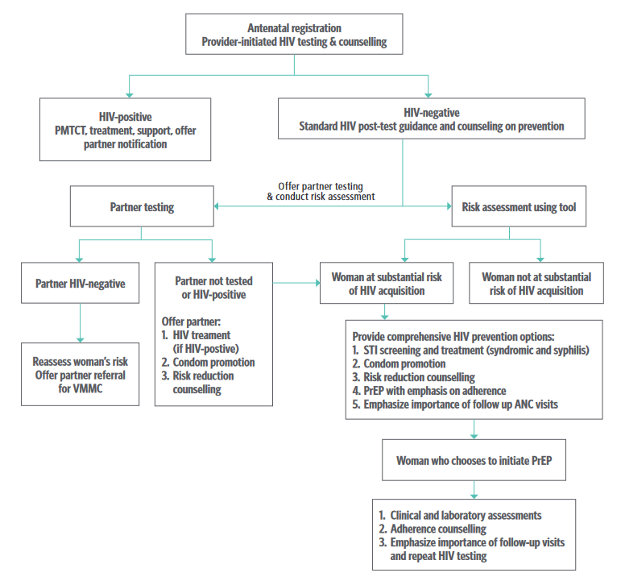
WHO: Integration of PrEP Delivery in Prenatal Care
https://apps.who.int/iris/bitstream/handle/10665/255866/WHO-HIV-2017.09-eng.pdf. VMMC: voluntary medical male circumcision

Slide 36
Real-world implementation of PrEP in 16 maternal and child health clinics in a region with high HIV prevalence (antenatal HIV prevalence >20%)
Of 9376 pregnant or postpartum women, 21.7% initiated PrEP
Predictors: younger age, having a partner living with HIV, being dx or treated for a STI, IPV, injection of drugs.
Having a partner living with HIV was the only predictor of PrEP continuation at 1 month.
Kinuthia, J. 2020. The lancet HIV, 7(1), pp.e38-e48

Slide 37
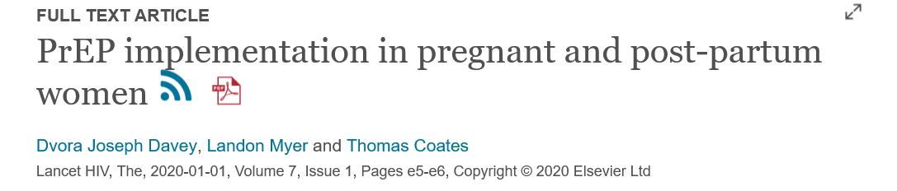
This study shows that maternal and child health clinics could potentially be an effective platform for PrEP delivery because of existing services for the prevention of mother-to-child transmission and integrated HIV testing and retesting of HIV-uninfected women; however, it also indicates that advising and dispensing PrEP are, alone, unlikely to be sufficient to protect all pregnant women at risk for HIV.

Slide 38
U.S. Context
Limited literature on how to operationalize PrEP in routine prenatal and postpartum care
Findings presented at OB/GYN Grand Rounds resulted in buy-in
Implementation strategies
  Clinical protocols
  Smart order set and smart phrases embedded in EMR
  Involvement care coordinators and PrEP navigator
  Going away from using risk-based PrEP counseling
  Asking about partner HIV status

Slide 40
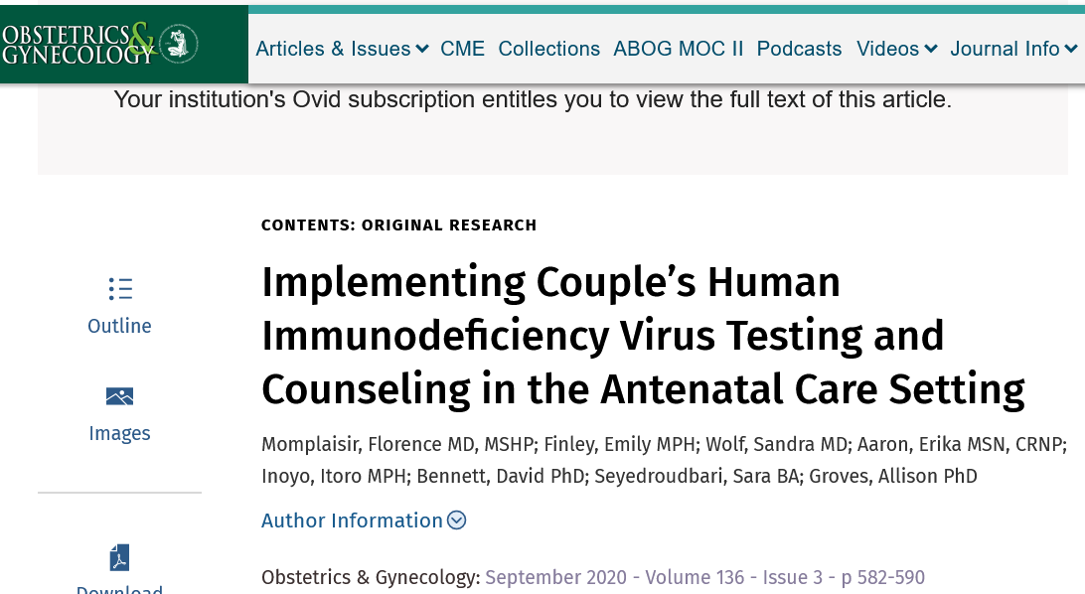

Slide 41
Rationale
Pregnant women in HIV–serodiscordant partnerships are at risk of HIV acquisition when the partner with infection is not on ART or not virally suppressed.
Pregnant women in serodisordant relationship are more likely to initiate and maintain PrEP.
A significant number of men do not know their HIV status because of lack of access to primary care resulting in lack of HIV testing. Among those who are aware of their status, a large proportion do not disclose to their female partners.¹
In general, couples struggle to initiate discussions about HIV testing, disclosure, and risk reduction behaviors.
Shifting this responsibility to the health care system.
1. Ciccarone DH. Am J Public Health 2003;93:949–54.

Slide 42
World Health Organization, 2012. Guidance on couples HIV testing and counselling including ART for treatment and prevention in serodiscordant couples

Slide 43
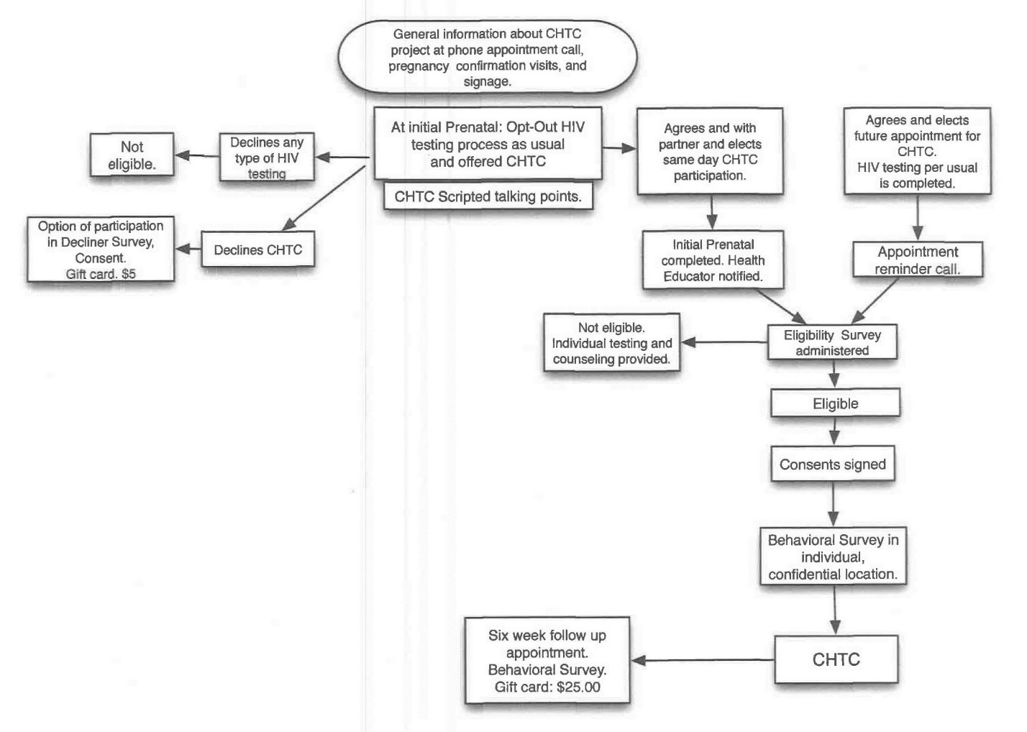
Change in clinic work-flow

Slide 44
Eligible couples from April 2016-July 2017 (n=525)
Not approached (n=428)
Approached for recruitment (n=97, 18%)
Declined (n=56)
Consented to the study (n=41, 42%)
Completed Decliner Survey (n=41)

Slide 45
Participant Characteristics (n=82)
Characteristics | Value
Age (y), mean (SD) | 28±8
Black, n (%) | 60 (733)
Hispanic or Latino, n (%) | 5 (6)
High school or lower, n (%) | 48 (59)
No. of living children, median (range) | 1 (0-8)
Married, n (%) | 18 (22)
Partners living together, n (%) | 58 (71)
Receive emotional support from your partner? Yes, n (%) | 76 (93)

Slide 46
Barriers to intervention uptake
Low initial enthusiasm from the patients.
Low show-up rate of male partners .
Among the partners who came, some of them did not have an identification card, which was originally needed to confirm the man’s identity and create an entry in the EMR. After discussion with the clinic leadership, this requirement was waived.
Turnover of the trained tester occurred, which required identifying and additional training.
No funds/limited resources allocated to CHTC.

Slide 47
Facilitators to intervention uptake
Buy-in from clinic: medical clinic director and staff viewed couple’s HIV testing and counseling as a high priority, and this support helped to integrate the intervention in the clinic.
Technical assistance from ID specialists who helped with developing clinical protocols and linkage to HIV care if or when individuals tested positive.
The clinic was also located within the same building as the prenatal care clinic.
Technical assistance from the Philadelphia Department of Public Health wo led the training of the testers.

Slide 48
Participant acceptability of the intervention
Acceptability of CHTC among participants (N=82) | No. of responses | VAS Score (mean, SD)
How would you rate the quality of the CHTC services you received? | 78 | 96±12
Was this counseling session a good format for providing HIV counseling and testing? | 78 | 96±7
How well did this counseling session meet your needs? | 76 | 93±14
How satisfied are you with counseling services you received? | 77 | 95±10
After receiving couple’s counseling, how confident do you feel about talking with your partner about safe sex? | 76 | 96±8
After receiving couple’s counseling, how comfortable do you feel talking with your partner about safe sex? | 78 | 96±7
If a friend or family member were in need of HIV testing and counseling, would you recommend couple’s counseling to them? | 78 | 96±10

Slide 49
Reasons for declining
Reported reason(s) for declining CHCT (n=41 women) | N (%)
Scheduling conflict for partner | 10 (24)
Don’t need to get tested for HIV | 9 (22)
Partner is incarcerated | 4 (10)
Partner perceived to be at low risk for HIV infection | 3 (7)
Partner does not want CHTC | 2 (5)
Woman perceived to be at low risk for HIV infection | 1 (2)
Preference to knowing HIV status first | 1 (2)
Other reasons | 22 (54)

Slide 50
Limitations
Focus was on the barriers and facilitators of implementing couple’s HIV testing and counseling.
No objective data on PrEP uptake.
Qualitative interviews are needed to understand the mechanisms driving low uptake (stigma vs structural barriers).
No data collected on ways to adapt the intervention to increase uptake (e.g., home-based testing, financial incentives to recover the opportunity time from work etc).

Slide 51
Conclusion
Prenatal care setting can serve as a potential conduit to expand HIV testing and to deliver PrEP to pregnant women and their partner.
Patient, provider, and clinic-level barriers and facilitators have to be assessed (and addressed) for the effective roll out of PrEP.
Obtain buy-in from clinic leaders, clinicians and staff to adapt the work-flow or using other evidence-based interventions (such as couple’s HIV testing and counseling) to discussing and initiating PrEP.
Approach has to be acceptable and feasible to the end-user and the clinic and needs to be adapted to the social context of patients’ lives.

Slide 52
Going back to the case
Woman acquired HIV through heterosexual sex from her male partner.
She was unaware of his HIV status.
No one during the clinical encounters asked about her partner’s HIV status; therefore, HIV testing was not offered to him.

Slide 53
Acknowledgment
Clinical Team:
  Helen O. Dickens Center for Women
  Drexel Women’s Health Clinic
Research Team:
  Allison Groves, PhD
  Erika Aaron, MSN CRNP
  Valerie Raziano, MPH
  Jessica Vadaketh, MD
  William Short, MD
  Emily Finley, MPH
  Sandra Wolf, MD
Funding:
  Center For AIDS Research
Patients

