Slide 1
A Learning Assessment of Structural Racism: Where we are and where we need to be
Margarita Alegria, PhD¹ and Idia Thurston, PhD² Chief, Disparities Research Unit, Massachusetts General Hospital, Mongan Institute Professor, Departments of Medicine & Psychiatry, Harvard Medical School
This Project was funded by the Robert Wood Johnson Foundation Grant # 78682
Northwestern PSMG Virtual Grand Rounds

Slide 2
No Conflicts to Disclose

Slide 3
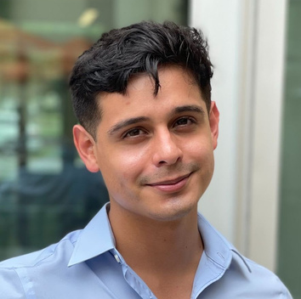
RESEARCH TEAM
Dr. Idia Thurston
Dr. Margarita Alegria
Principal Investigator
Principal Investigator
Christian
Herrera
Danielle Porter
Audrey Saculla
Dr. Debra Pérez
Sheri Markle
Rodolfo Estrada
Isabel O'Malley
Marie Fukuda
And many more staff, interns, and contributors…

Slide 4
Aims of the Study
We had three main objectives:
1) to compile needed evidence on organizational policies, programs and practices that demonstrate an association with organizational change in inclusion and equity for URM scholars in academic health sciences
2) to build a framework that identifies the main mechanisms potentially leading to organizational change
3) to create a toolkit to help academic institutions assess needed organizational change.

Slide 5
Methodology
Scoping Review
Quantitative Data
Future Directions
Qualitative Interviews
AT A GLANCE

Slide 6
Scoping
Review
METHODOLOGY:
Mixed Methods Approach
RWJFLA
Qualitative
Interviews
Quantitative
Survey

Slide 7
With the online survey, we sought to understand…
1
…student, faculty, and staff experience at their institutions
2
…their perceptions of approaches to increase racial and ethnic equity in academic health sciences

Slide 8
Survey Design
Survey instrument: Redcap
Data collection occurred from December 17, 2021 to March 1, 2022
Included questions adapted from existing surveys as well as new modules designed for this study
Questions heavily focused on diversity, equity, and inclusion, adapted to focus on race and ethnicity; included questions on belonging
Included quantitative and open-ended questions

Slide 9
Findings from the Quantitative Survey

Slide 10
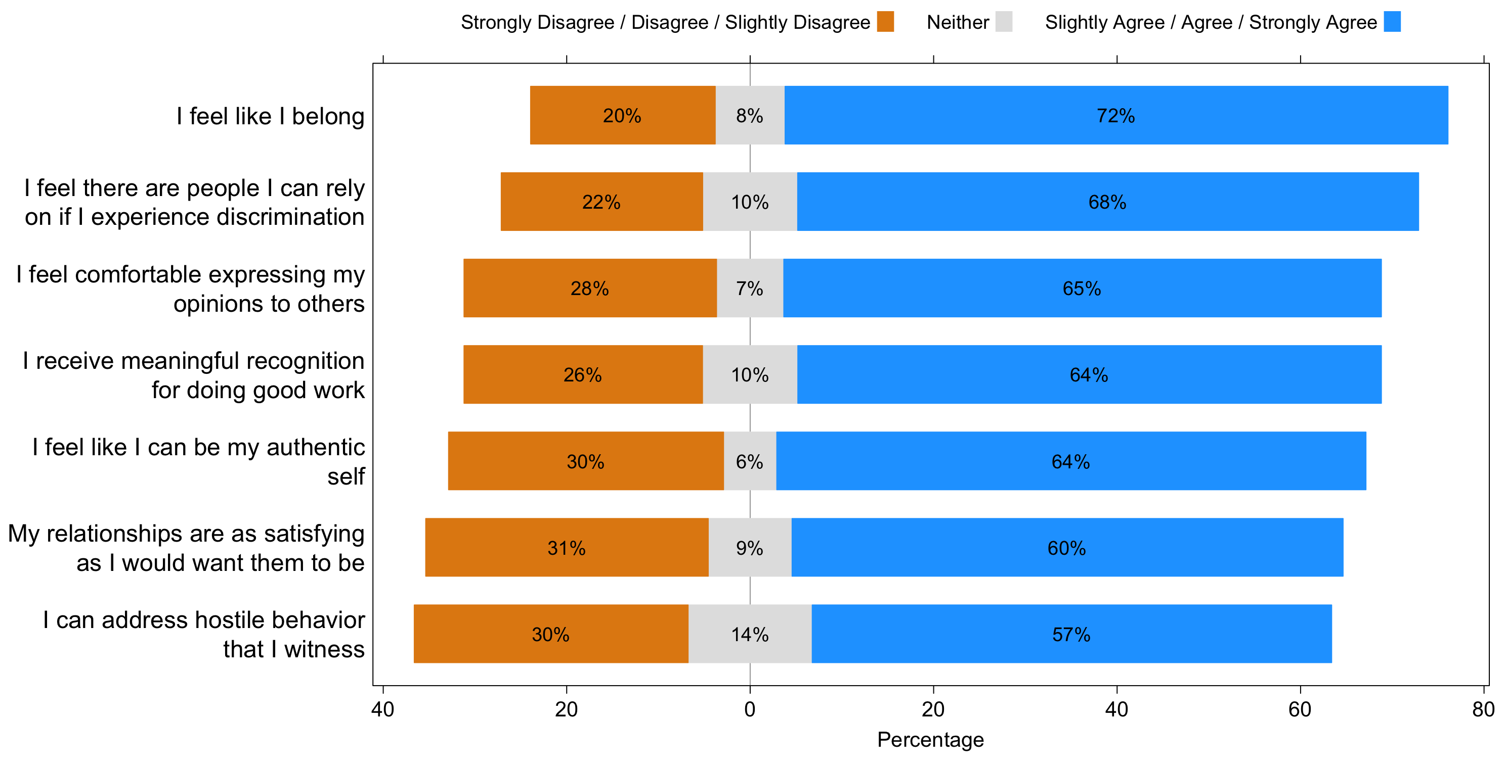
We aimed to understand participants’ feelings of inclusion and belonging at their institutions

Slide 11
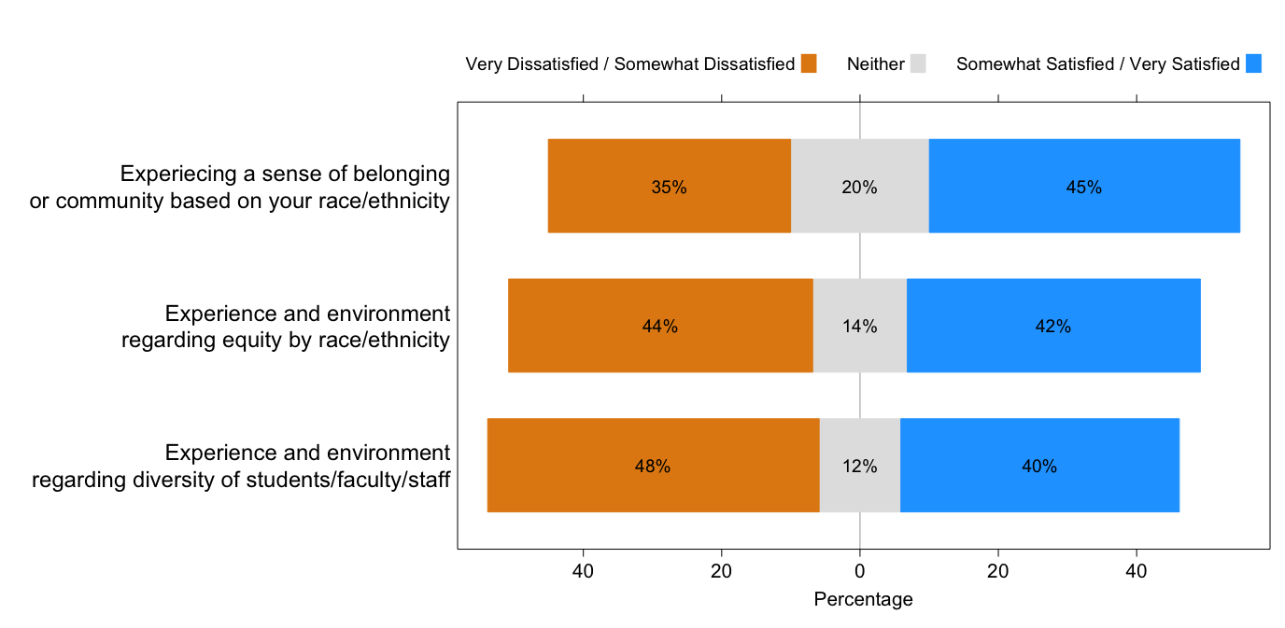
Satisfaction with institutional environment based on participants’ sex and race and ethnicity

Slide 12
Experiences of racial/ethnic and gender discrimination were highly prevalent
Females and racial and ethnic minorities were more likely to report racial/ethnic discrimination
Females were much more likely to report gender discrimination

Slide 13
Participant Qualitative responses reflect the challenges of address and reporting discriminatory behavior
“I have witnessed several professors make racial remarks to students. I reported this, and the consequences seem to be minimal, given that the professor remains in the same position and never had to correct their behavior. I was told there were consequences behind closed doors. It is important that addressing racial or other discriminatory behavior is not a hidden process that incites shame, but rather an open process that promotes learning and change, because that was probably not the only professor who has made racist or discriminatory comments in our institution.”
“There is secondary trauma to the persons who report racial discrimination and a re-establishment of the power structures that lead to racism and discrimination, which leads to an environment that is psychologically unsafe.”

Slide 14
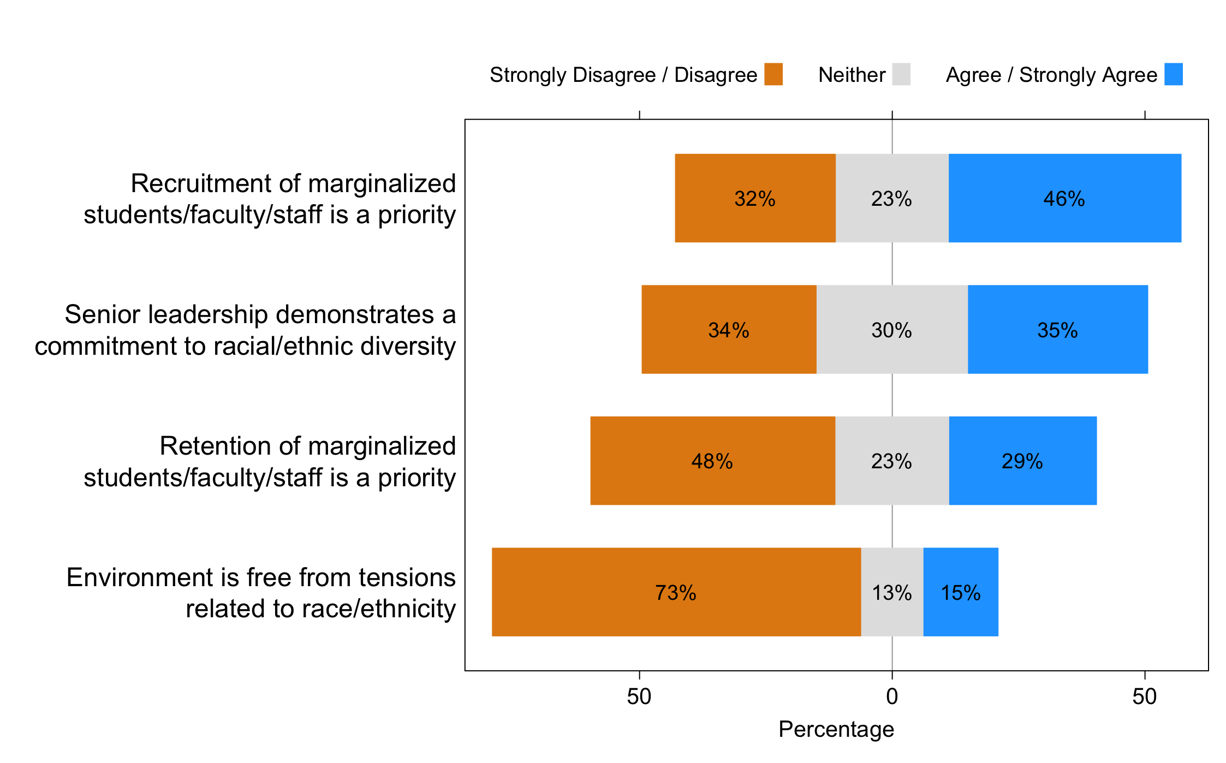
We also aimed to understand Participants’ point of view regarding their institutional environment

Slide 15
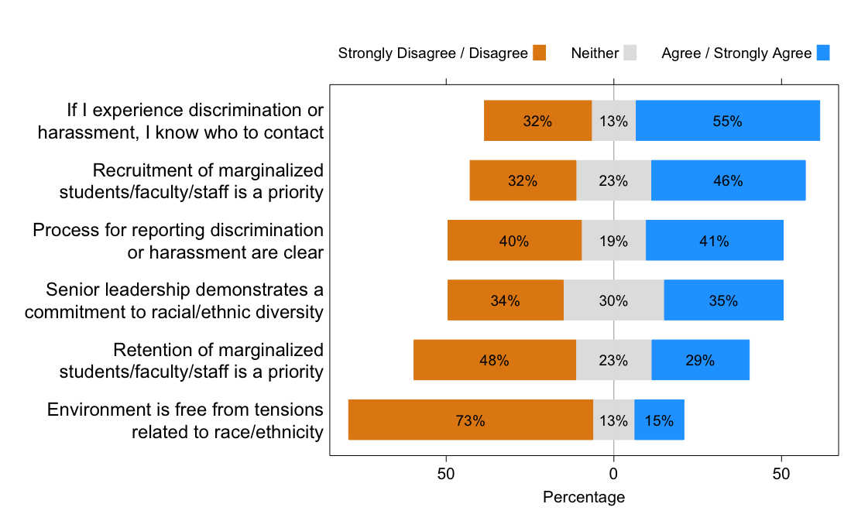
Participants’ perceptions of their institutional environment

Slide 16
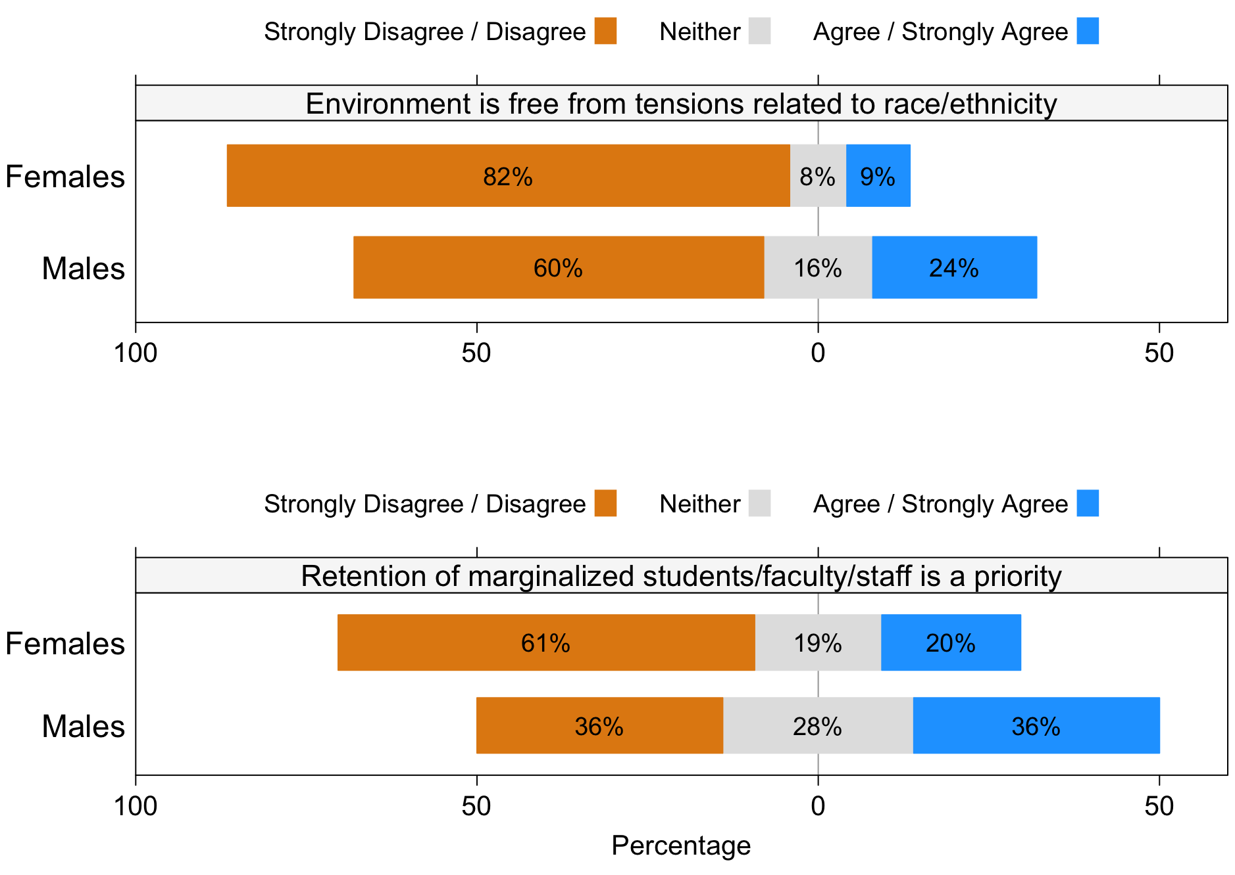
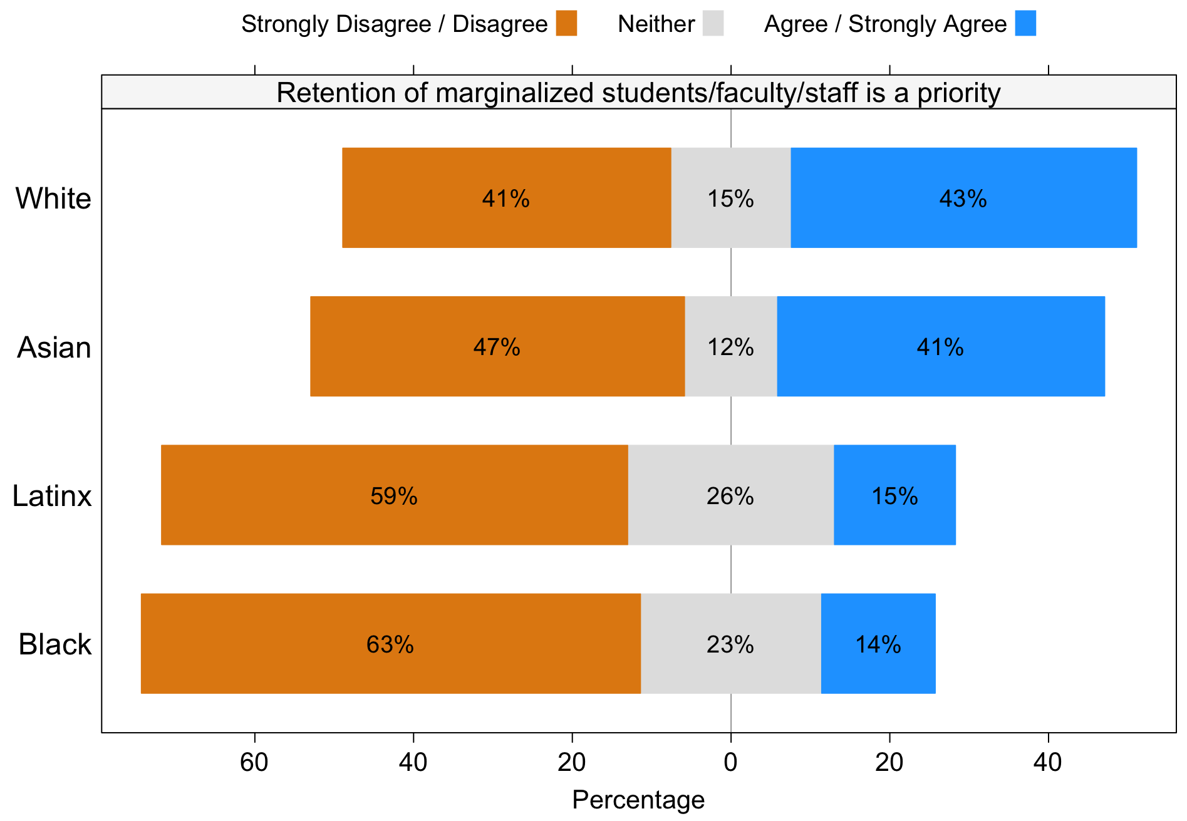
Some of these points of view regarding the institutional environment were Also different based on participants’ sex and race and ethnicity
Females Perceived more racial/ethnic tensions and felt less that retention of URM persons was being prioritized
Fewer Black and Latinx participants felt that retention of URM individuals was being prioritized

Slide 17
Qualitative commentary displays these challenges
“There is a lot of talk and little action. Most of the DEI efforts are just for show and there is no real commitment to make foundational and substantive changes.”
‘”There are many women and underrepresented minorities that experience discrimination and just deal with it. It impacts their science, and all aspects of their engagement with the institution.”
“We have a lot of money, but the commitment to addressing racial/ethnic equity really isn't there.”
“My institution is notorious for promoting a surface solution that does more harm than good because it hasn't addressed the deep internal rot.”
“Although the system in general has monies to support a variety of efforts to address concerns of racial/ethnic equity, it is not a priority. Faculty of color are leaving my university at alarming rates.”

Slide 18
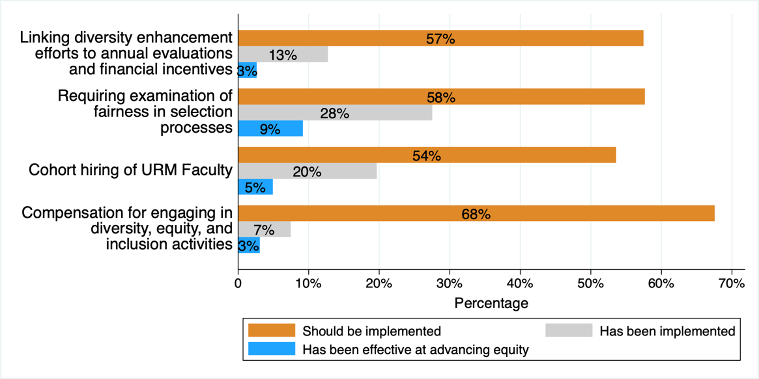
Participants’ opinions about different strategies to support racial/ethnic equity
Category 1. Recruitment and Hiring of Staff and Faculty
In most cases, participants reported that although many of the following strategies have been implemented, they have not been highly effective at advancing equity.

Slide 19
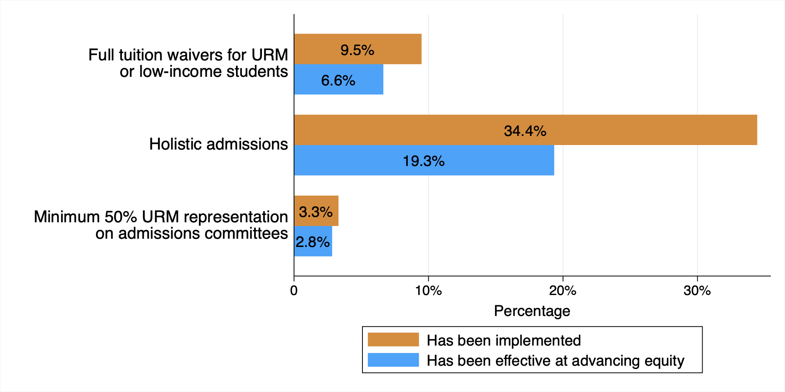
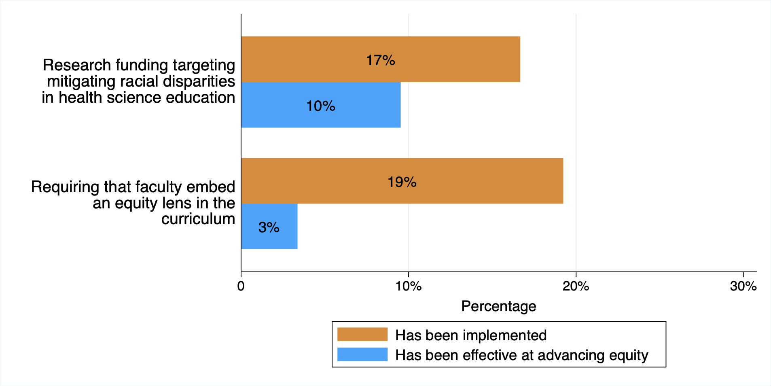
We asked Participants their opinion about different strategies to support racial/ethnic equity across Five categories Cont.
Category 2. recruitment and admission of students
Category 3. Teaching and learning with students

Slide 20
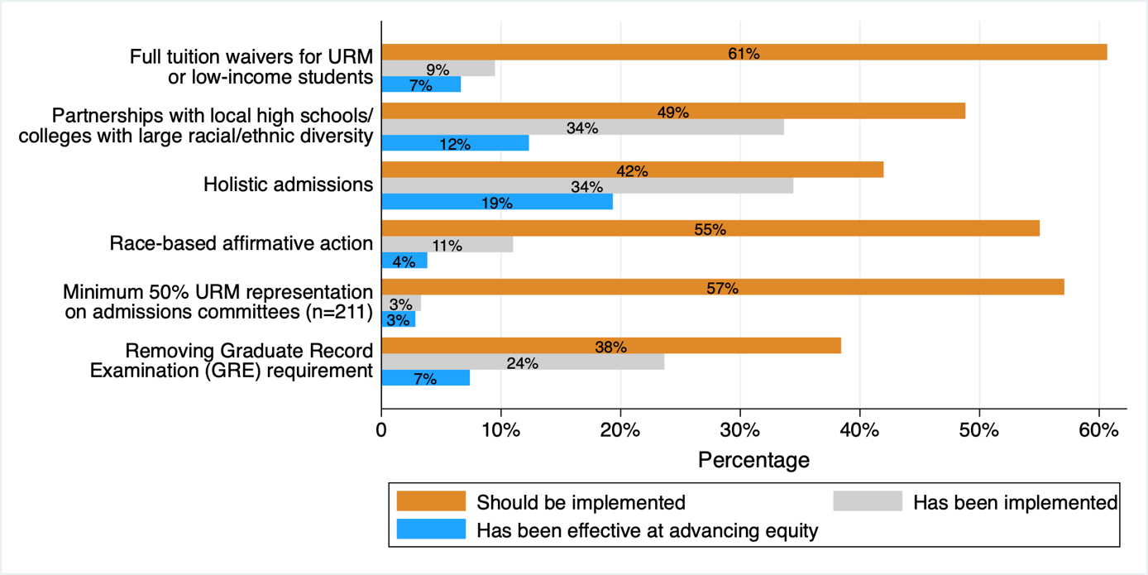
Participants’ opinions about different strategies to support racial/ethnic equity
Category 2. Recruitment and Admission of Students

Slide 21
Qualitative responses SUGGEST WHY THEY ARE NOT WORKING
“This requires systemic change, changes in hiring, ability to address ongoing inequities, retention and training — this system is designed to maintain hegemony and there is no amount of money that can fix that. Cultural change is required.”
“There needs to be greater efforts still to increase diverse faculty hires, donor outreach to support scholarships for underrepresented students and endowed chairs for faculty who do equity-centered work. Increased intramural funding for faculty (particularly junior) who are doing equity-centered work.”
“Diversity, Equity, and Inclusion efforts are not enough as they tend to situate us in an individual mindset and continue to place the responsibility on one person or marginalized departments. Institutions need to think about equity from a systems perspective and as a core function to their work.”
“Honestly, most URM faculty at my institution live close to a major urban center and drive 45 minutes to work. They don't feel safe and welcomed in the community surrounding our institution. This should be addressed by upper administration. This certainly impacts retention.”

Slide 22
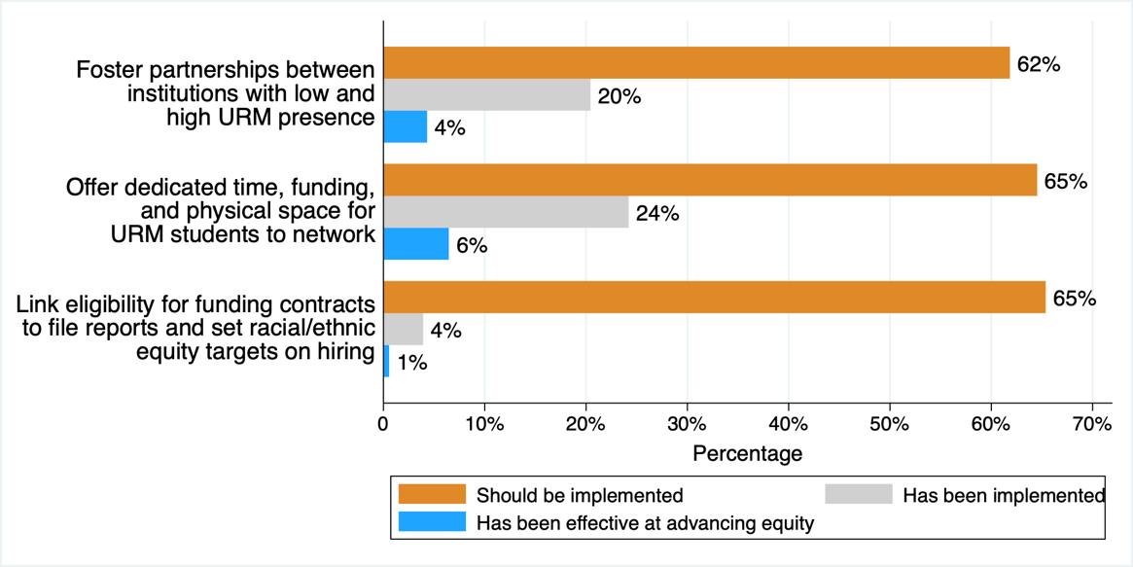
Participants’ opinions about different strategies to support racial/ethnic equity
Category 5. Structures, facilities, and community space

Slide 23
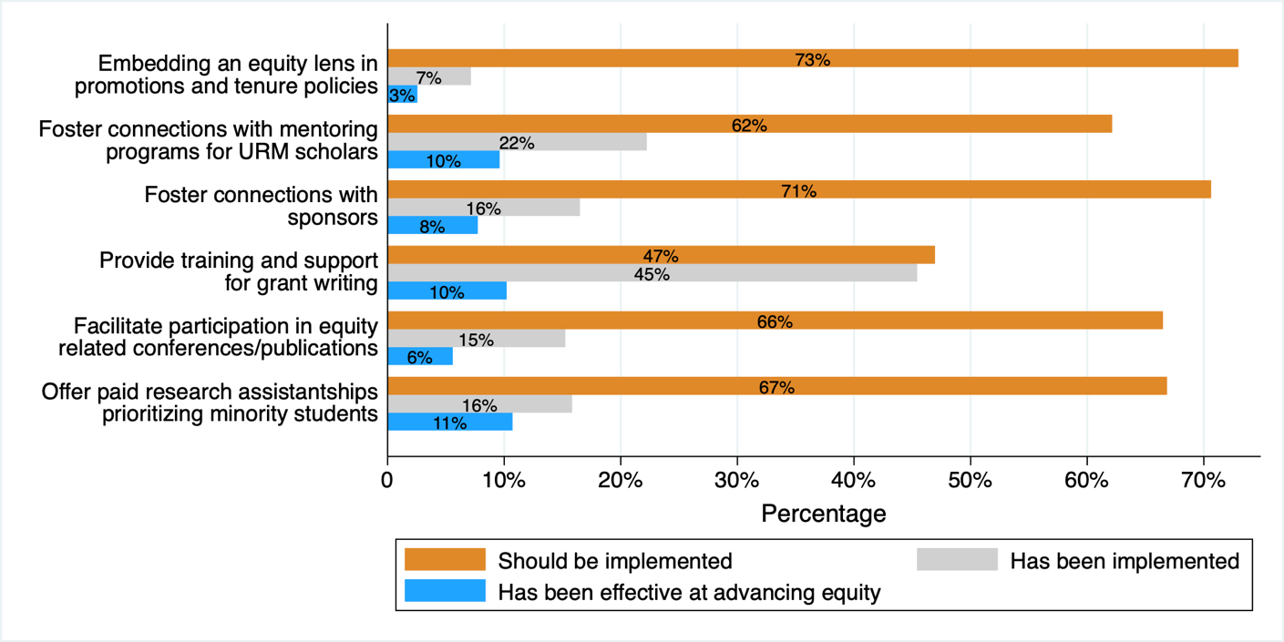
Participants’ opinions about different strategies to support racial/ethnic equity
Category 4. Career development and promotion for students, faculty, and staff

Slide 24
Participants’ opinions about different strategies to support racial/ethnic equity
Category 5. Structures, facilities, and community space

Slide 25
Recommendations for retention and promotion
“Ensure that URM students get the same boosts that their privileged counterparts get, like having their name put forth for an opportunity, publishing early and often in a well-supported environment.”
“Recognize and count the personal experience that we use to help others understand equity issues, the experiences that do not come from a classroom, but being in the classroom as a URM student.”
“Create a system of review and 365-degree review that includes community members and BIPOC faculty, staff and students of all top level university leadership positions from presidents to provost chairs and more with metrics that assess DEI & belonging.”
“Examine and publish URM retention data at faculty level, including level of resources/support given relative to peers, and collect exit interview data to actually determine barriers for faculty retention.”

Slide 26
Stakeholders with change making capacity and funding are key
“There is a DEI committee at my college, but they do not have authority to address specific complaints. The overall institution hired a VP for DEI who has been in place for about 5 years. She is making a slow difference, but I am elated that there is a Presidential cabinet person in place to SLOWLY decrease the institutional racism.”
“Being willing to have ‘truth and reconciliation’ sessions about systemic racism and its effects on faculty and students.”
“The ability to change leadership, bring in more faculty of color and create supportive programs that provide faculty and students the tools to challenge racism and discrimination. It also has the resources to make the culture truly integrative, allowing faculty and students to be themselves and show up fully without having to white wash aspects of themselves to be accepted.”
“I honestly believe our University President and many key administrators are willing and committed to diversity consciousness. However, the sociohistorical dehumanization at our institution is structural.

Slide 27
Strategies to advance racial equity in the academic health sciences:
A Scoping Review Protocol
i. What strategies (e.g., policies, programs, practices, regulations, resources, organizational partnerships, and initiatives) have been implemented and evaluated to advance racial equity in the academic health sciences?
ii. What strategies have reduced institutional racism?
iii. What strategies have increased the recruitment, retention, research productivity, and promotion of underrepresented students, faculty, and staff?
Protocol registered 11-24-2021 and publicly available on Open Science Framework
https://doi.org/10.17605/OSF.IO/CFKTA

Slide 28
Inclusion criteria for scoping review
Studies of higher education institutions that implemented and evaluated strategies
(e.g., policies, programs, or practices) to advance racial equity (e.g., in recruitment, retention, research productivity, or promotion) among students, faculty, or staff from racial and ethnic groups that are under-represented in the academic health sciences (i.e., African American, Black, Hispanic, Latinx, American Indian, Alaska Native, Pacific Islander, Native Hawaiian, Southeast Asian, Multiracial)
Studies conducted in English, from 1960-2021, in any country, in academic health science settings

Slide 29
Our Scoping Review Process
1
2
3
4
5
Search
Title, abstract screening
Full-text review
Data extraction
Charting data, writing report
Conducted by two independent reviewers; conflict resolved through discussion or third reviewer

Slide 30
366 primary sources with a program evaluation
As of June 1, 2022

Slide 31
Findings from the Scoping Review

Slide 32
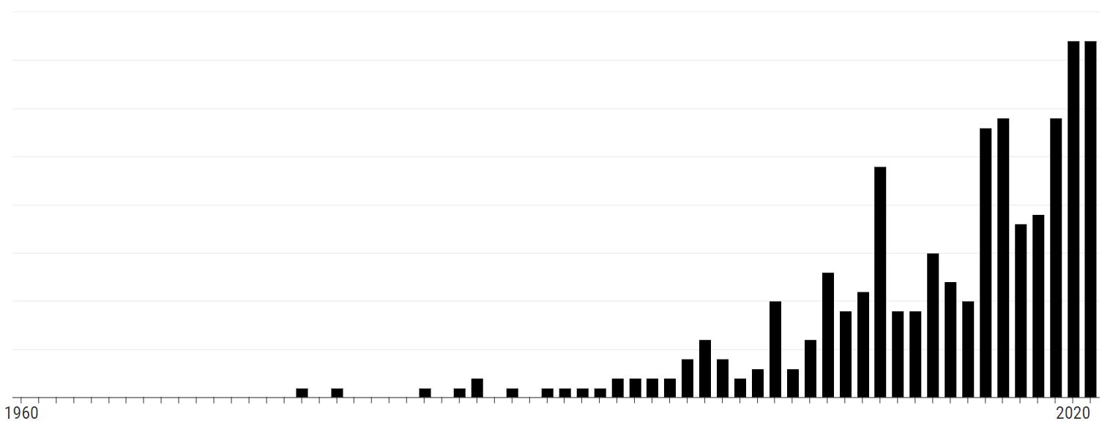
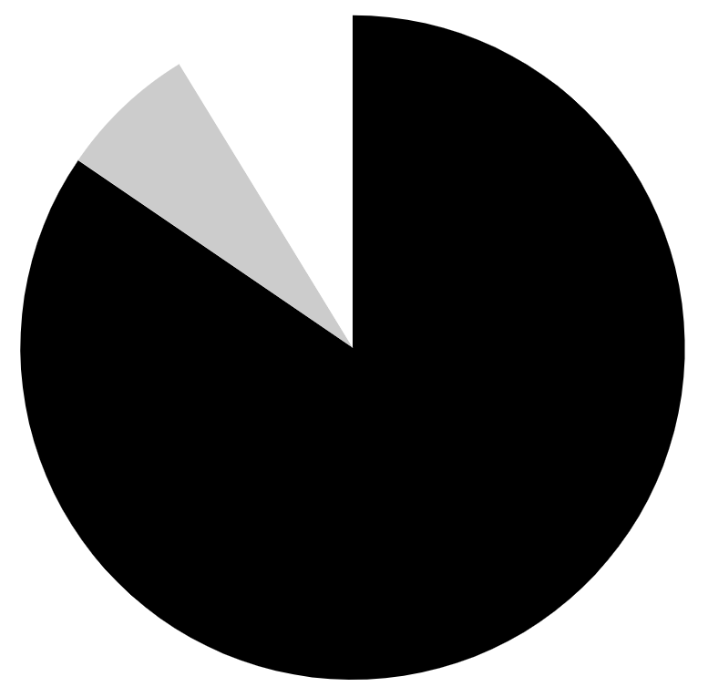
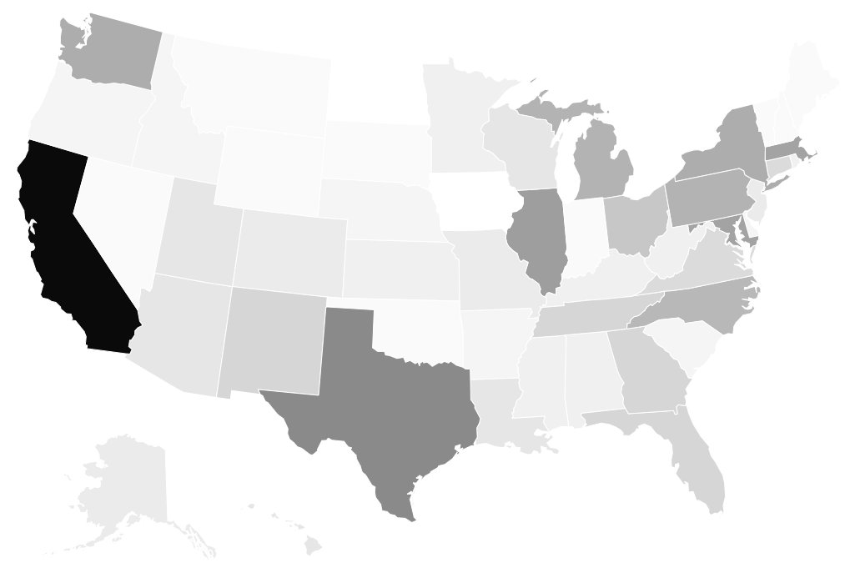
Study Characteristics
366 (91.3%) articles were primary sources
339 (84.5%) were intervention studies, and 27 (6.7%) were observational studies.
The publication of primary articles in this field has increased in the last ten years.
338 (92.3%) primary articles evaluated strategies implemented in U.S. institutions.
The states most frequently found in our scoping review were CA (48, 13.1%), TX (23, 6.3%), IL (19, 5.2%), MD (18, 4.9%), and MA (18, 4.9%).
The following counts only include primary articles
Notes:
Article Type:
Primary Source: Intervention Study (339, 84.5%)
Primary Source: Observational Study (27, 6.7%)
Secondary Source: Commentary, “Best Practices,” or Topic Overview (25, 6.2%)
Secondary Source: Scoping or Systematic Review (7, 1.7%)
Other (includes commentary, overview with primary data) (3, 0.7%)
Country:
United States (338, 92.3%)
New Zealand (5, 1.4%)
South Africa (5, 1.4%)
United Kingdom (5, 1.4%)
Australia (4, 1.1%)
Canada (4, 1.1%)
1 study was included from Barbados, Iran, Norway
*Responses for country and state are not mutually exclusive

Slide 33
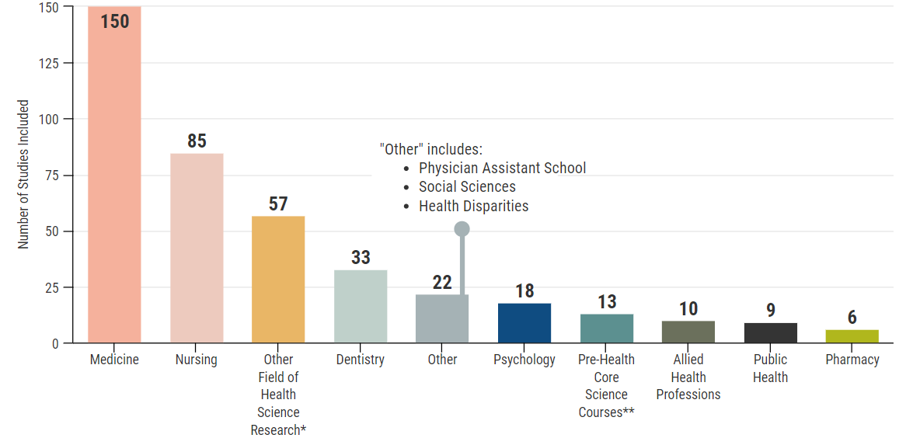
Number of studies included by Health Science Discipline Targeted
*examples of health science research include biomedical research, cancer research
**pre-health core science courses include basic science curriculum at undergraduate colleges/universities
As of June 1, 2022

Slide 34
Characteristics of Populations Assessed
Undergraduate (169, 46.2%)
Doctoral (134, 36.6%)
Evaluations of strategies at the student level have been published more frequently than those targeting faculty, staff, and administration.
Faculty
(68, 18.6%)
Staff
(18, 4.9%)
Administration
(6, 1.6%)
Diversity and inclusion strategies in the fields of medicine (137, 37.4%), nursing (81, 22.1%), and health science research (58, 15.8%) have been most often evaluated.
In 69 (18.9%) primary articles, no specific racial/ethnic group was named. In 137 (37.4%) primary articles, not all included racial/ethnic groups were specified.
Black or African American populations were included in 230 (62.8%) primary articles
Latinx or Hispanic populations were included in 214 (58.5%) primary articles
Notes:
Degree Level:
Associate (14, 3.8%)
Undergraduate (169, 46.2%)
Masters (41, 11.2%)
Doctoral (134, 36.6%)
Post-Doctoral (e.g., trainees, residents) (48, 13.1%)
Faculty (68, 18.6%)
Staff (e.g., lab managers, administrative directors, building services) (18, 4.9%)
Administration (e.g., hospital president or university dean) (6, 1.6%)
Other (includes high school, post-baccalaureate, international education levels) (48, 13.1%)
Discipline:
Medicine (137, 37.4%)
Nursing (81, 22.1%)
Other field of health science research (58, 15.8%)
Dentistry (34, 9.3%)
Psychology (18, 4.9%)
Pre-health core science courses (12, 3.3%)
Public health (8, 2.2%)
Pharmacy (5, 1.4%)
Allied health professions (4, 1.1%)
Physician assistant (2, 0.55%)
Other (includes health professions, in general, social sciences, specific health fields) (47, 12.8%)
Racial/ethnic groups included:
Black or African American (230, 62.8%)
Latinx or Hispanic (214, 58.5%)
Asian (130, 35.5%)
Indigenous or American Indian or Alaska Native (127, 34.7%)
White (127, 34.7%)
Native Hawaiian or Pacific Islander (52, 14.2%)
Multi-racial (48, 13.1%)
Other (16, 4.4%)
No specific racial/ethnic group was named (includes articles that said “URM” but did not specify racial/ethnic groups in their sample, even if defined in introduction) (69, 18.9%)
Not all included racial/ethnic groups were specified (includes articles that may have specified one race/ethnicity within URM without defining other groups included in designation) (137, 37.4%)
*Responses are not mutually exclusive

Slide 35
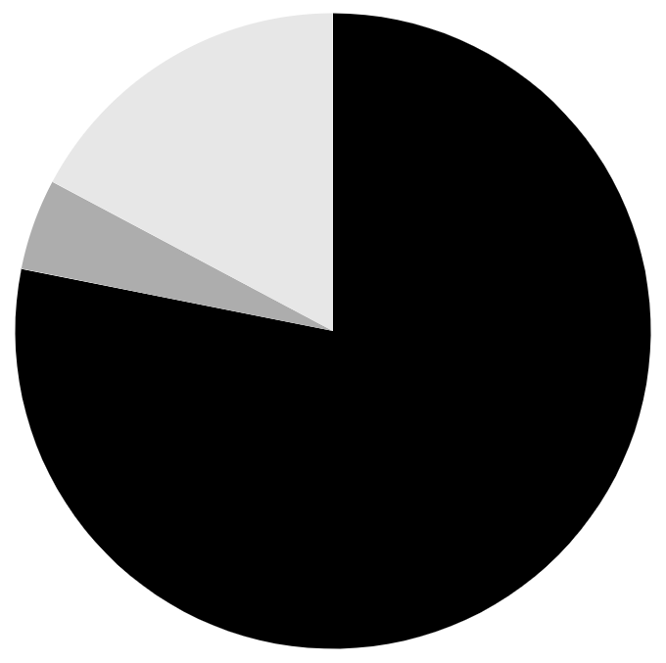
Characteristics of Evaluation Methods
Most primary articles (286, 78.2%) used quantitative evaluation approaches.
Stronger design
Randomized controlled trials (6, 1.8%)
Mixed methods (63, 17.2%)
Quasi-experimental (5, 1.5%)
Qualitative (17, 4.6%)
Pre/post intervention with a comparison group (23, 6.8%)
Pre/post intervention with no comparison group (102, 30.1%)
Quantitative (286, 78.2%)
Weaker design
Cross-sectional (e.g., just post-intervention) (189, 55.7%)
Notes:
Evaluation methods used:
Cross-sectional (e.g., just post-intervention) (189, 55.7%)
Pre/post intervention with no comparison group (102, 30.1%)
Pre/post intervention with a comparison group (23, 6.8%)
Quasi-experimental (5, 1.5%)
Randomized controlled trials (6, 1.8%)
Other (includes longitudinal, retrospective, cohort) (14, 4.1%)
Evaluation approaches used:
Quantitative (286, 78.2%)
Qualitative (17, 4.6%)
Mixed methods (63, 17.2%)
The lack of use of rigorous evaluation designs (e.g., randomized controlled trials) and qualitative and mixed methods evaluation approaches represent a gap in the literature assessing diversity and inclusion initiatives. The relative lack of qualitative and mixed methods evaluation approaches indicates that nuanced experiences have not been adequately captured.

Slide 36
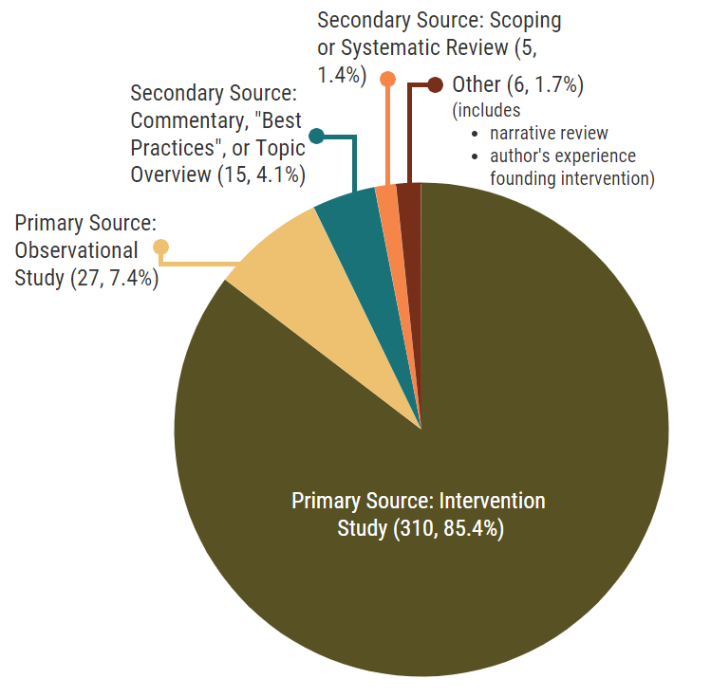
Article Types
As of June 1, 2022

Slide 37
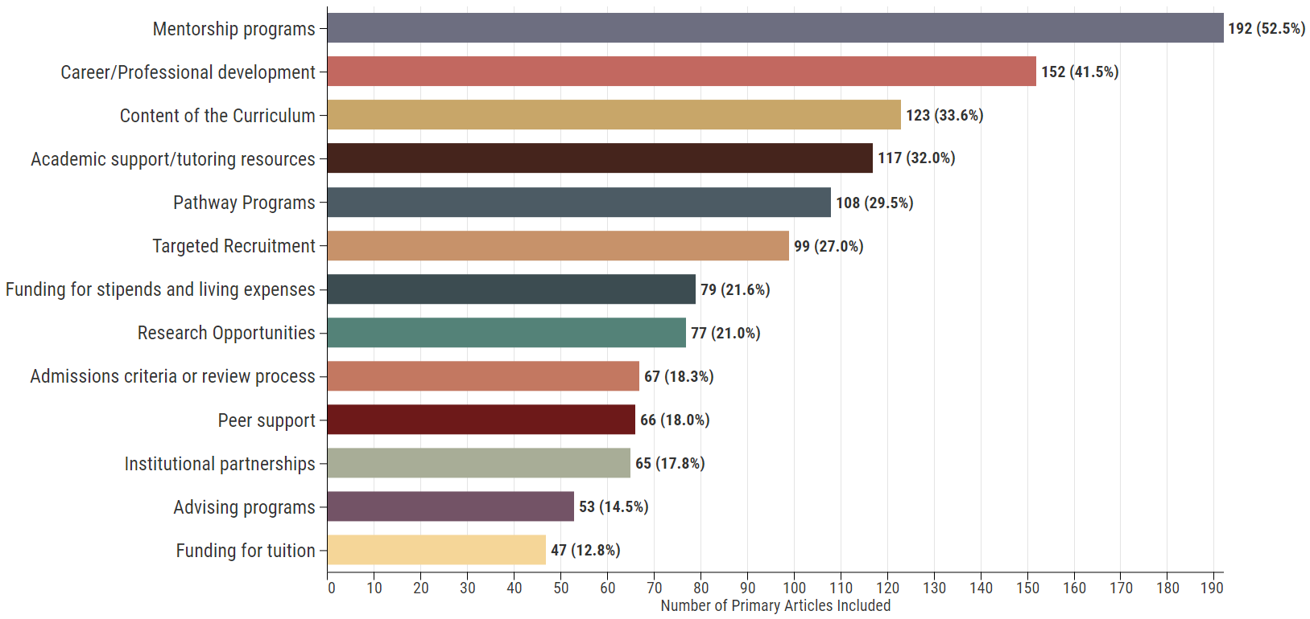
Strategies/interventions most frequently evaluated
The most frequently evaluated interventions were strategies targeted at the individual level (e.g., mentorship programs, career/professional development, academic support/tutoring resources, pathway programs).
Notes:
*Responses not mutually exclusive

Slide 38
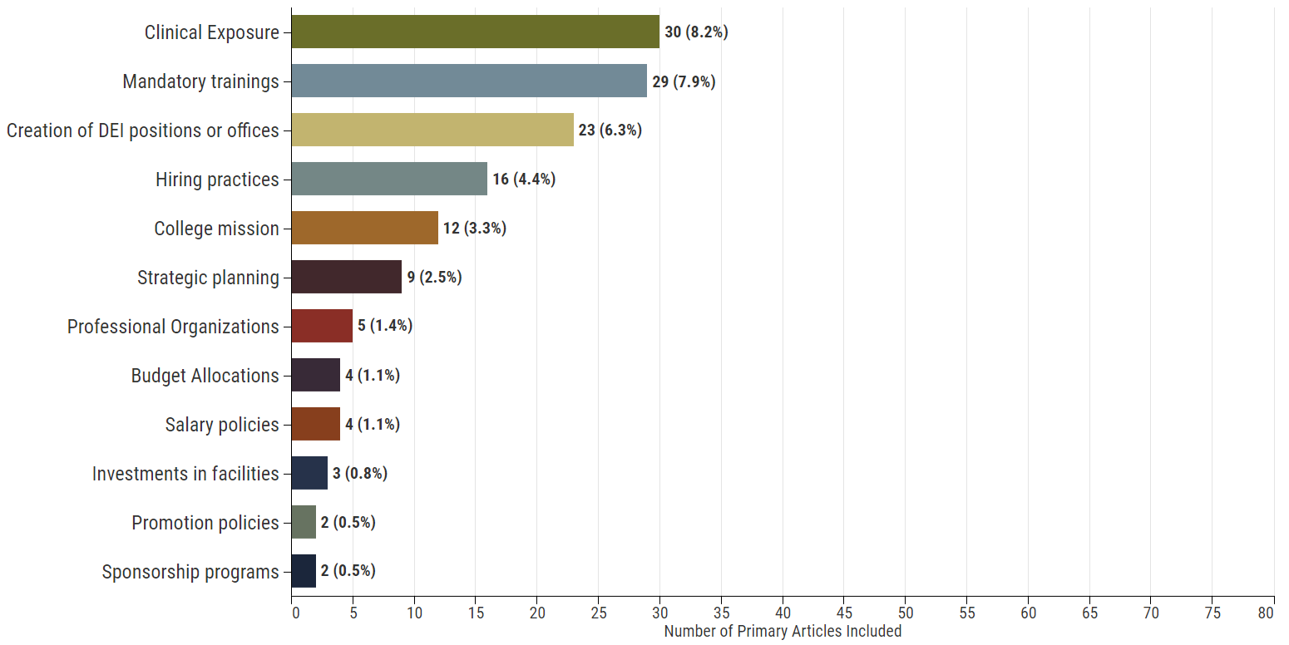
Strategies/interventions least frequently evaluated
The least frequently evaluated interventions were strategies at the institutional level (e.g., hiring practices, college mission, strategic planning, budget allocations, salary policies, investments in facilities, promotion policies).
Notes:
*Responses not mutually exclusive

Slide 39
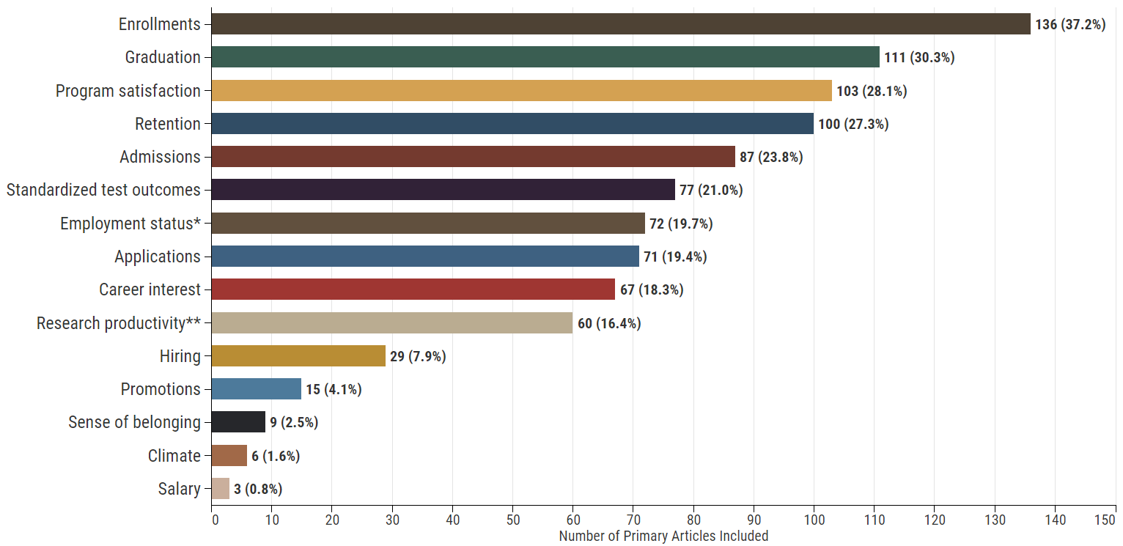
Outcomes reported
There is a gap in studies assessing faculty-level outcomes (e.g., hiring, promotions, salary) and outcomes assessing institutional environment (e.g., climate, sense of belonging).
*e.g., in health field
**e.g., papers, grants, posters
Notes:
*Responses not mutually exclusive

Slide 40
COMMON LIMITATIONS OF STRATEGIES
ELEMENTS OF PROMISING STRATEGIES
1. Interventions are narrowly focused only at the individual level without changes at the institutional level
2. Institutional/structural racism not named or specifically addressed in 90% of studies' strategies
3. Even pathway programs persist using biased and exclusive eligibility criteria
4. Workforce development at department or office level without changes at institutional level
5. Light-touch surface-level "interventions"
1. Change and evaluate institutional policies (e.g., payment, promotion)
2. Programs and policies that describe specifically how they target structural racism
3. Expand eligibility for participation in pathway programs and degree programs
4. Institutional partnerships for career development
5. Ongoing scholar networks that build lifelong relationships

Slide 41
Promising Strategies and Studies

Slide 42
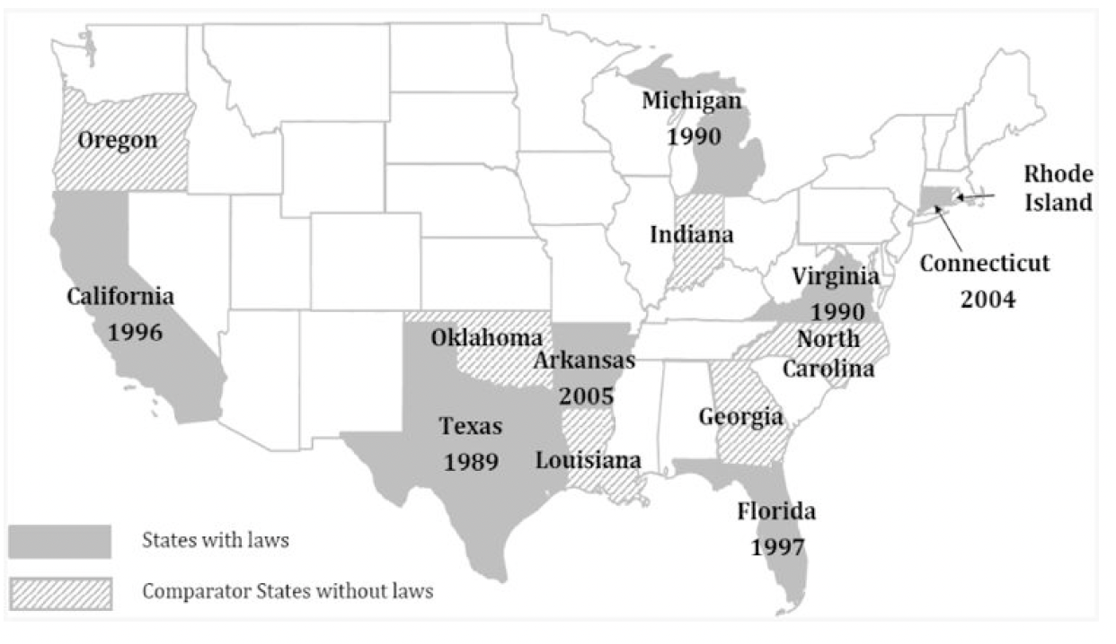
1. Change and evaluate institutional policies
Affirmative Action Policy (Roseby, 2019)
Doubled # of Aboriginal employees from 24 to 57 within 12 months
State legislation on minority recruitment to nursing careers (Travers 2015)
7 states with laws & 7 neighboring comparator states without laws
Equity strategic plan
(Pino-Jones, 2021)
Within medical school department, with online dashboard tracking metrics, and salary equity interventions
One of Australia’s largest Academic Health Centres. Interviews all self-identified Indigenous applicants with required qualifications. If they meet criteria, automatically become preferred applicant, offered a position
Senior administrators were enthusiastic. Middle-level management was resistant.
Legislation tied to reimbursement, funding, and encouragement proved to have greater effects on minority enrollment
Findings suggest state legislation does increase minority nursing enrollment, but may be insufficient to meet state-based demographic representation for Black and Hispanic populations
Within 1 year, all physician faculty’s salaries were at the goal benchmark, and differences in salary for similar years of rank were nearly eliminated
All faculty in similar roles now have similar amounts of protected time
Notes:
Travers 2015:
All states reached adequate representation of the AI/AN/HPI population post-legislation
First study to evaluate the effects of state legislation on minority recruitment to careers in nursing

Slide 43
2. Programs and policies that describe specifically how they target structural racism
Multimethod Antiracism Intervention in Residency
(Guh, 2019)
Developed curriculum for faculty and residents with information and self-work. Implemented mandatory race workshops.
Pathway Program Addressing Obstacles to UIM Recruitment and Retention (Escalante, 2021)
Resident-Led DEI and Antiracism (Karvonen, 2021)
The diversity committee organized special events for UIM applicants during recruitment season to offer support, including “Diversity Days” and “Second Look” opportunities.
From 2014 to 2017, increase from 28% (10/36) to 68% (27/40) of residents self-identified as POC.
The residency program has seen an increase in the number of UIM interns, from 2 of 40 (5%) interns in 2014 to 21 of 41 (51%) interns in 2021
"The number of matriculating UIM interns increased from 3 (11%) in 2015 to 14 (50%) in 2021"
The diversity task force changed interview scoring rubrics to place greater value on the lived experience of being a POC. The rank system was adjusted, and a new academic threshold was established to better represent POC applicants.
Residents and faculty engage with UIM potential applicants at local, regional, and national recruitment and career development fairs. Offer travel stipends to reduce obstacles for interviews.
Implemented the Minority Senior Scholarship Program, a pathway program for UIM medical students combining clinical experiences. Diversity dinner series mitigate isolation and mentorship challenges for UIM residents.
Diversity committee members are included in Ranking Advisory Committee to support the thoughtful review of UIM applicants and incorporate holistic review and eliminate the “global ranking score”

Slide 44
3. Expand eligibility for participation in pathway programs and degree programs
Redesign of Bachelors of Science in Nursing program
(Rami, 1994)
Multi-pronged retention strategies, without changing "open admission" 80% African American Students
Health Equity Scholars Program
(Upshur, 2018)
2/3 students have GPA < 2.9, average ACT test score of 14 (lower than average for admission)
80% timely graduation rate v. 42% campus average and 37% among students of color
Pathway for undergrads, prioritized students with fewer qualifications
Within 4 years, national licensure exam pass rates from 50% to 95% (higher than average)
94% of graduates employed in the field
Post-bac Pre-med Program
(Blakely, 2003)
For students who did not get into med school on 1st try, low MCAT scores - Focus on developing study skills and test taking
Significant improvement in MCAT science section scores
From 0 accepted, to 90.4% accepted to medical school within 1 year

Slide 45
4. Institutional Partnerships for Career Development
Emory Clerkship
(Goines, 2020)
Started in 1999, the clerkship includes ongoing mentorship & residency application prep
PROMISE
(Tull, 2012)
2017 – Emory clerkship became a course within Morehouse curriculum
Proportion of Morehouse class matching into Emergency Medicine began to increase following the 1999 partnership (odds ratio 1.10, 95% CI 1.01-1.20, p = .03) from 3% in 1999 to 15% in 2017, above national average of 9%
Phillips Health Careers Institute
(Foote, 2006)
Enrolled nearly 1,000 students, > 35% from the Phillips neighborhood, > 80% are people of color
Students experienced a 27% increase in income, average starting wage of $10.94 (in 2006)
Students earned medical certificates (e.g., nursing, phlebotomy) through a community college, and 3 local hospitals guaranteed jobs after graduation. 1997-2007
By 2003, opened professional development services to all URM masters and doctoral students in STEM across 3 campuses. By 2022, includes 18 institutions in MD
Across 3 original campuses, URM applications, enrollment, and PhD graduates have seen 45%, 44%, and 45% increases, respectively, from pre (1997–2002) to post implementation (2003–07)
Focus groups and surveys: alliance programs helped students secure internal and external funding, supplemented weak departmental advising, and helped them stay on track and motivate

Slide 46
5. Strengthening scholar networks
Indigenous Faculty Forum
(Carney, 2021)
Instruction on academic advancement; addresses unique cultural considerations; networking and ongoing career support
CDC Ferguson Fellowship
(Belcher, 2019)
Quasi-experimental mixed methods study: N = 62 AI/AN faculty of US health professions schools 2017-18
22-item Diversity and Engagement Survey (DES): only significant change post-session to 1 year was "Respect", M 3.42 (SD = 0.77) to 3.76 (SD = 0.67), p = .05
TRANSCENDS
(Tagge, 2021)
23 scholars: 14 Hispanic/Latinx; 7 Black/African American/1 Asian; 1 biracial; 46 mentors
Across all cohorts, the scholars averaged 7.8 total scientific publications each (almost 2 publications per year per mentee)
Career development program for URM junior faculty and post-residency fellows in academic neurology. Monthly webinars; American Academy of Neurology meeting activities; opportunities for research, feedback, networking
54 graduate students in 10-week program, Atlanta or Baltimore, on infectious disease research. Only half received M3 mentorship (individual development plan and research accountability groups)
Abstract submission to conferences increased from a low of 46.2% in 2012 to 80% in 2014 (figure in article)
Only Ferguson Fellows who received M3 showed significant increases in transformational leadership characteristics (p < .01). Plus 3.9 higher odds (p < .05) of submitting research to a national scientific meeting

Slide 47
Preliminary Recommendations
1. Investing in strategies, interventions, and initiatives that have the potential to make long-lasting and deep institutional changes. Most strategies are for individual change and short-term, so need to shift to prioritizing and implementing system-level changes.
2. Investigating the disconnect between what appears to be a strong commitment to improving diversity and inclusion, as seen in the literature, and what is a negative perception, as seen by survey respondents and interviewees. Survey respondents and interviewees reported a worse image of diversity and inclusion efforts. Looking into the reason for this disconnect will help identify where this gap lies, what is needed, and what works and does not work to improve racial equity and inclusion.
3. Identifying metrics and creating standardized measures and methods for tracking improvements in institutional racial diversity and inclusion, may help with setting realistic and achievable goals. There was a sense of pessimism in the quantitative survey responses and qualitative interviews and a sentiment that this type of change requires generations. Setting achievable goals can help drive and direct motivation, but we must identify what those targets are.

Slide 48
Preliminary Recommendations
4. Dismantling silos and improving communication about what has worked and what has not is paramount. It is necessary that institutions collaborate and share findings and innovations.
5. Fund interventions targeting racial and ethnic minority groups in predominantly white institutions (PWIs). Programs in PWIs may not be including racial and ethnic minority individuals, even if it is the program’s intention.
6. Reverse bans on policies of affirmative action. Bans on affirmative action have been instated in some places. However, academic and employment settings implementing affirmative action policies have seen an increase in their institution’s compositional diversity.
7. Create grant opportunities that last longer than a typical grant cycle. One challenge discussed by articles found in the scoping review was the inability to sustain programs and initiatives due to the nature of grants and external funding.

Slide 49
Preliminary Recommendations
8. Fund the development and evaluation of long-term interventions. As reported by survey respondents, diversity and inclusion efforts are often surface solutions and do not make efforts to deeply change systems.
9. Design and implement holistic strategies that meet the needs of URM individuals and faculty. Efforts to improve retention and support URM individuals must be multi-pronged and multi-targeted, incorporating elements of mentoring, academic support, career and professional development, financial support, peer support, mental health support, and scholar networks that build lifelong relationships.
10. Incentivize innovation in dealing with structural racism, such as programs on changing budgets, hiring practices, and changing the climate of the organization. Many of the interventions are reduced to training, mentoring and providing academic support.

Slide 50
Success of POC
If you were to make a list of the important things people of color in the academic health sciences need in order to be successful, what would you put on that list?
Systemic, Organizational, Individual Innovation
Innovation
What is your understanding of how your institution/organization is innovating to improve racial and ethnic diversity at the systemic/organizational level rather than the individual level?
What is your understanding of the ways in which your institution/organization is innovating to improve racial and ethnic diversity in their recruitment, retention, and promotion processes
Resources and Supports
What is your understanding of the resources and supports that are required to strengthen or create equitable systems that support racial and ethnic diversity and inclusion in the academic health sciences?
Next steps: In-depth interviews – in progress
Challenges or Barriers
What is your understanding of the challenges or barriers your institution/organization has experienced while developing and implementing initiatives to recruit, retain, and promote faculty/staff/scholars of color?

Slide 51
Scoping
Review
TRIANGULATION
Mixed Methods Approach
RWJFLA
Qualitative
Interviews
Quantitative
Survey

